Slide 1
Welcome to
History 110e: Rise of Machines

Slide 2
“. . . The Republic thunders past with the rush of the express . . . “
Andrew Carnegie, famous industrialist dude

Slide 4
John Perry Barlow

Slide 5
”It is impossible that old prejudices and hostilities should longer exist, while such an instrument has been created for an exchange of thought between all.” Editorial on telegraph, 1858
We are “drawing people together, thereby bringing about an era in which men, by knowing one another, will finally cease fighting.” Ferdinand de Lesseps

Slide 6
The New Economy?
“We’re breaking through the material conditions of existence to a world where man creates his own destiny.” Ronald Reagan, Moscow University, 1988

Slide 7
Did the Internet transcend . . .
Governments and law?
Identities?
Inequality?

Slide 8
In 1890 . . .
One percent of families owned 51 percent of all property
Forty-four percent owned only 1.2 percent

Slide 9
”Our inventions are wont to be pretty toys, which distract our attention from serious things. They are but improved means to an unimproved end . . . “ Henry David Thoreau, 1856

Slide 10
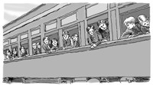
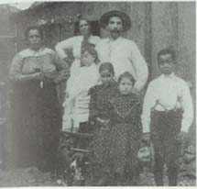
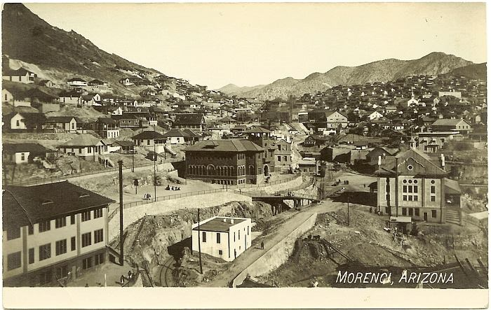
1904

Slide 15
The citizens of the United States must effectively control the mighty commercial forces which they have called into being.” – Theodore Roosevelt, 1910

Slide 16
“when you suddenly find your tongue twisted and your speech stammering as you seek to explain to your six-year-old daughter why she can't go to the public amusement park that has just been advertised on television. . . . "
Above: W.E.B. du Bois; right: Martin Luther King and Yolanda.

Slide 17
Three identification exams
A final essay exam
Section participation
A term paper

