Slide 1
Luna Park, Cleveland, 1901

Slide 2
Lower left to right: Franklin mucking around with lightening; a Volta battery; a Davy glowing wire

Slide 3
Right: one of Brush’s arc lamps in Cleveland.

Slide 5
Above: mockup of a light bulb; right, Paris exposition of 1881

Slide 6
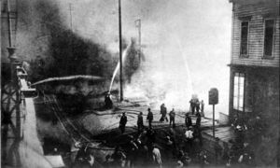
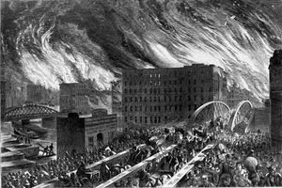
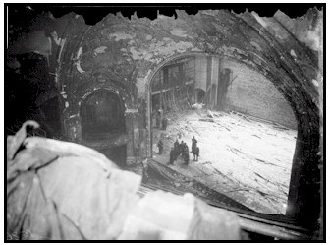
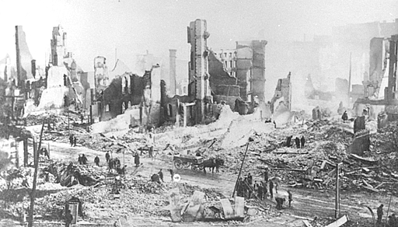
Clockwise from left: Chicago 1871; Seattle 1889; Chicago Iroquois Theater, 1903; Baltimore, 1904;

Slide 8
Right: Buffalo, New York in the 1880s; above: a trapped electrical worker

Slide 11
Chicago World’s Fair, 1893

Slide 14
Article I, Section 8, Clause 8 of the United States Constitution, known as the Copyright Clause, empowers the United States Congress:
To promote the Progress of Science and useful Arts, by securing for limited Times to Authors and Inventors the exclusive Right to their respective Writings and Discoveries.

Slide 15
Above: Kellogg’s “electric light bath.”

