Slide 1
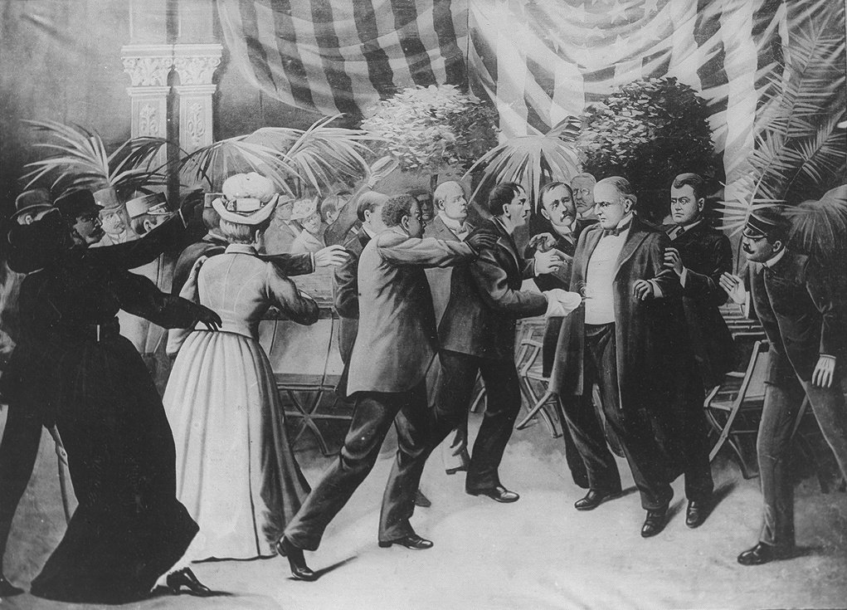
McKinley assassinated by Leon Czolgocz

Slide 2
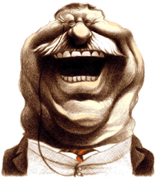
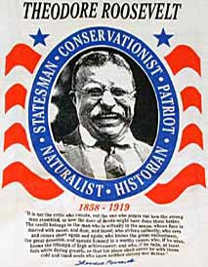
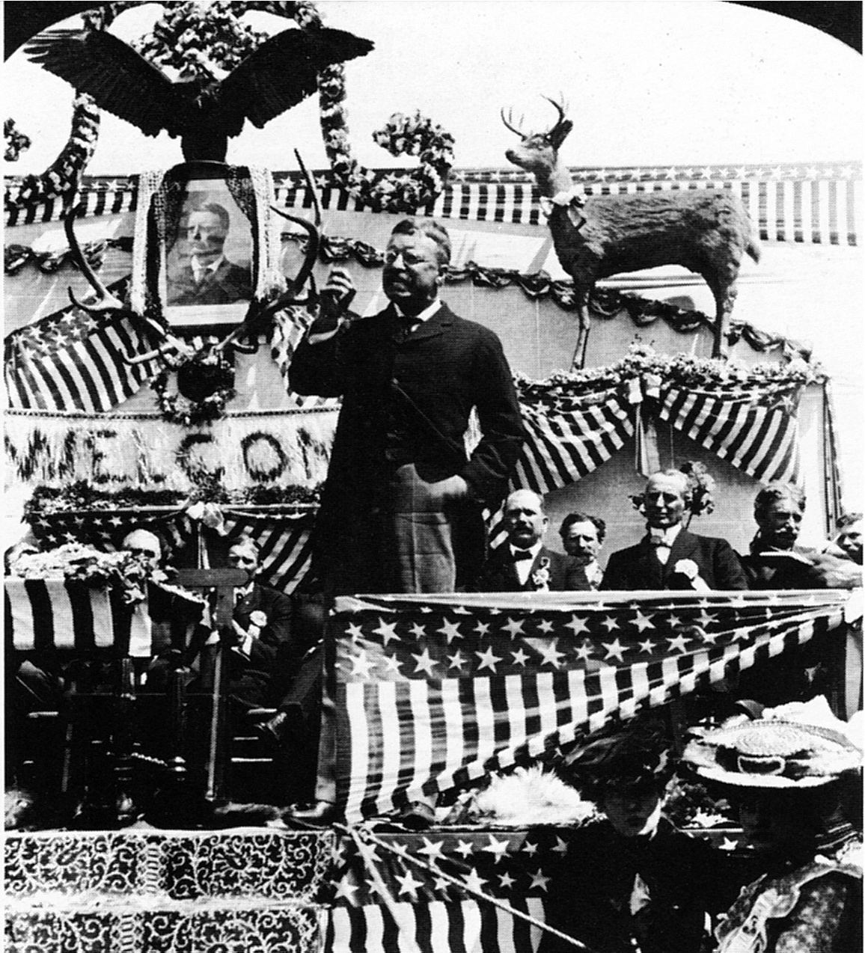
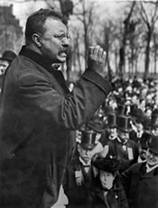
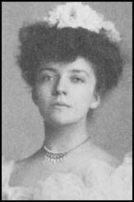

Slide 3
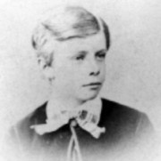
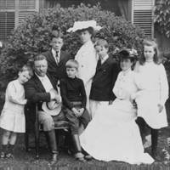

Slide 4
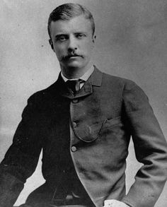

Slide 5
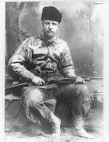
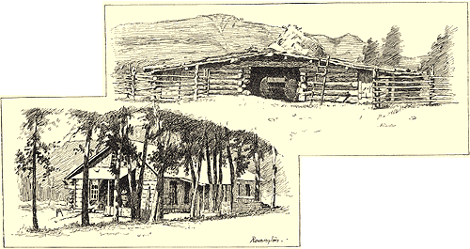
Roosevelt at his Elk Horn ranch in 1886

Slide 6
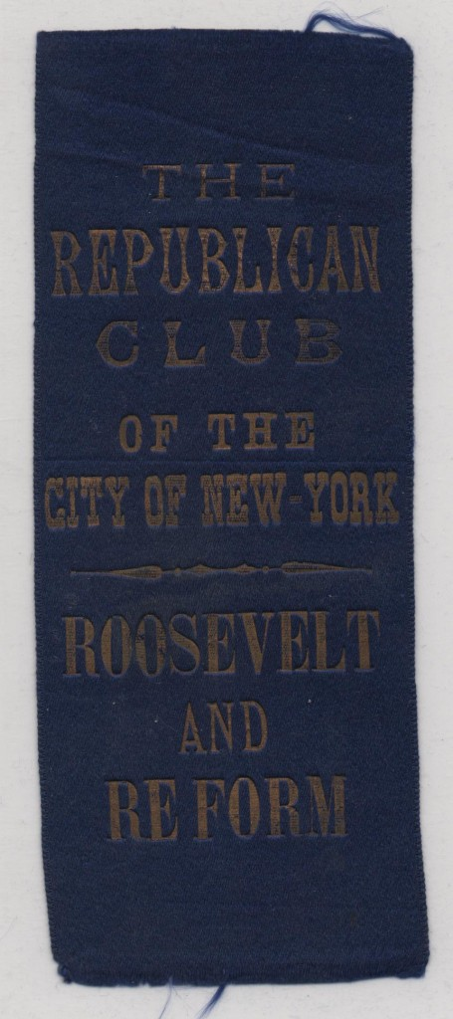
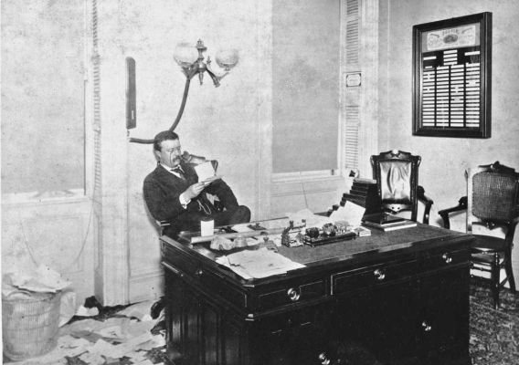
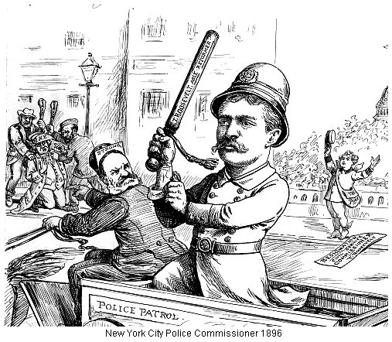
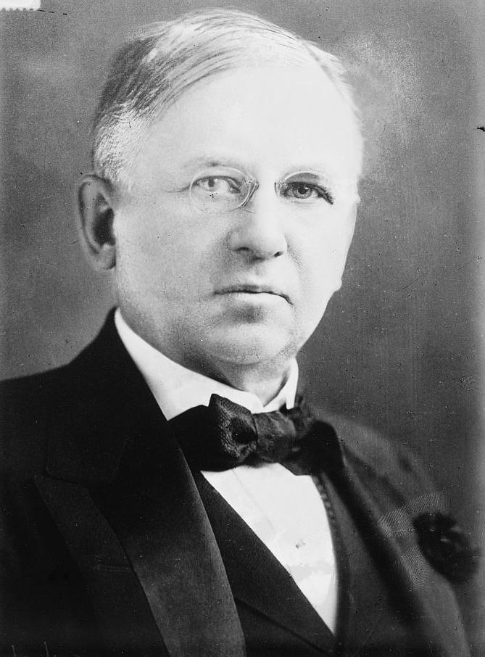
From left: a Roosevelt banner from 1886 electoral campaign; TR as NYC Police Commissioner; bottom: TR enemy John Wanamaker

Slide 7
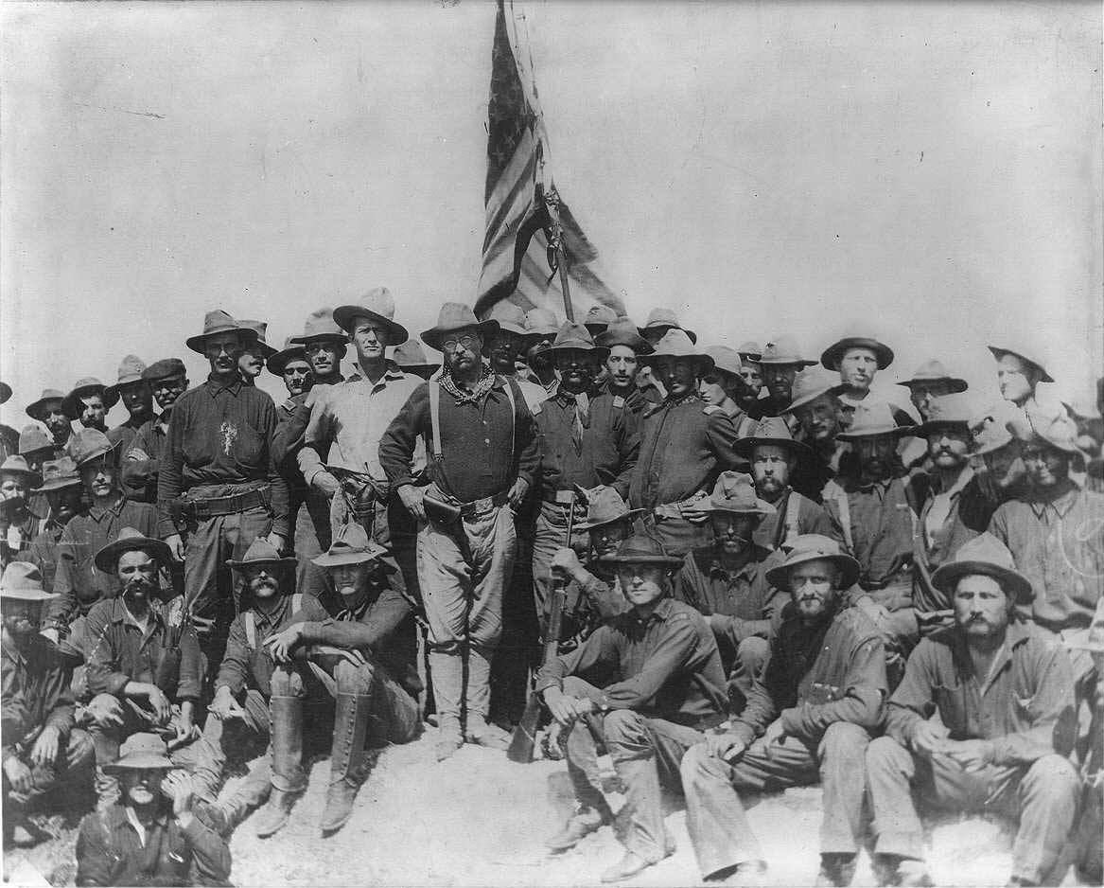
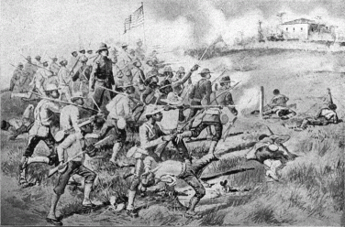
” . . . in the Spanish-American War of 1898, veteran black troops were more responsible than any other group for the United States victory.” – Historian Edward Van Zile Scott

Slide 8
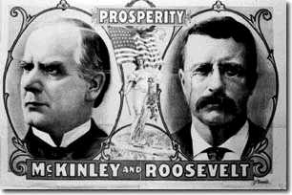
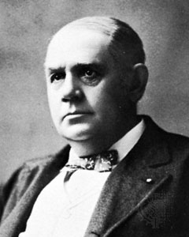
Above: TR’s inauguration; right: a demoralized Marcus Hannah

Slide 9
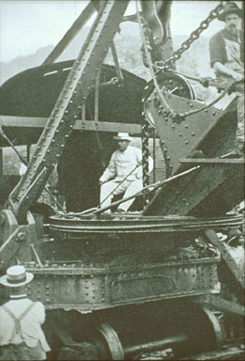
The Panama Canal, built by U.S. from 1904 through 1914

Slide 10
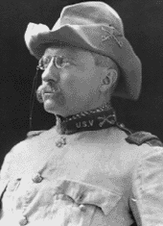
Roosevelt Corollary to the Monroe Doctrine December 6, 1904
“If a nation shows that it knows how to act with reasonable efficiency and decency in social and political matters, if it keeps order and pays its obligations, it need fear no interference from the United States. Chronic wrongdoing, or an impotence which results in a general loosening of the ties of civilized society, may in America, as elsewhere, ultimately require intervention by some civilized nation, and in the Western Hemisphere the adherence of the United States to the Monroe Doctrine may force the United States, however reluctantly, in flagrant cases of such wrongdoing or impotence, to the exercise of an international police power. “

Slide 11
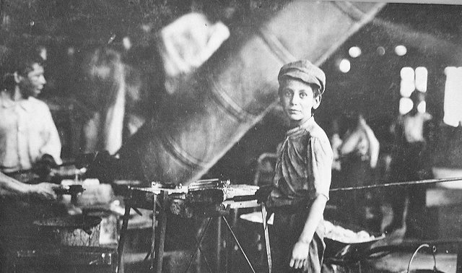
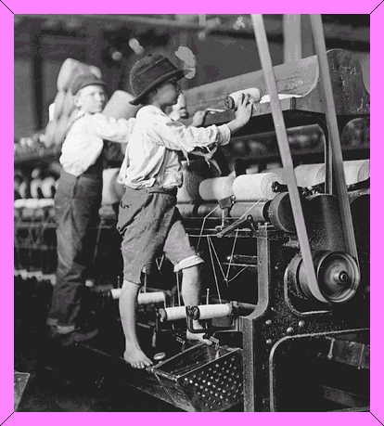
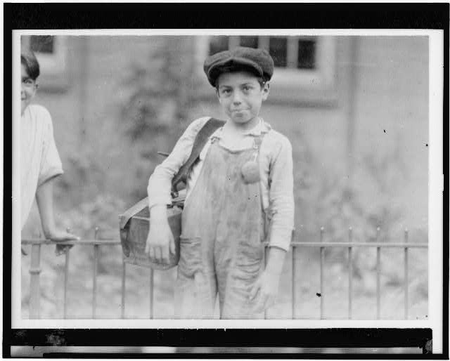

Slide 12
1904: 1,300 trusts in the United States
Aggregate capitalization of 724 billion dollars
Between 1897 and 1904, about a third of all previously existing companies disappeared
1909: 5 percent of manufacturers employed 62 percent of all manufacturing workers

Slide 13
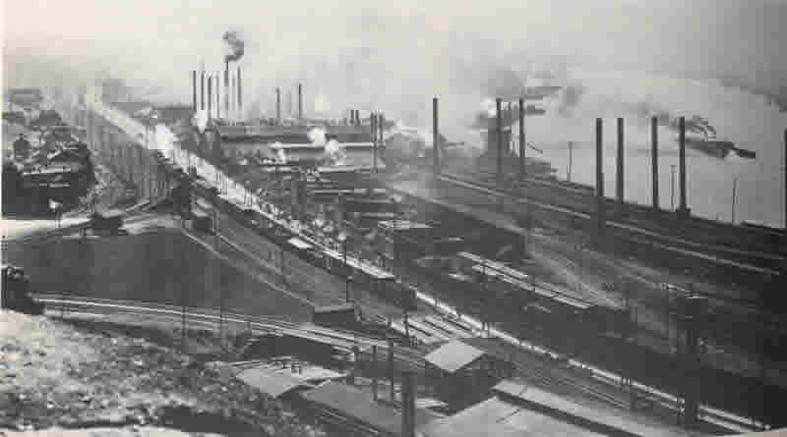
U.S. Steel, 1901
First billion dollar U.S. Corporation
11 companies
800 plants
Controlled 60 percent of all steel output in the U.S.

Slide 14
United Mine Workers
Founded in 1890 by members of the Knights of Labor
Grew from 30,000 to 300,000 members in 1908

Slide 15
Anthracite coal strike 1902
First time in U.S. history Federal government arbitrates a major strike
Commission discovers coal profits embedded in railroad books
Generates national sympathy for conditions of miners

Slide 16
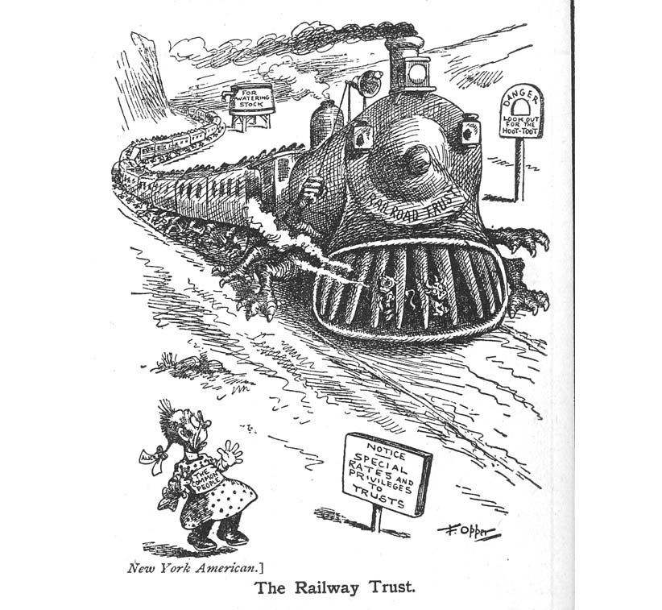
T.R. Prosecutes the Northern Securities Company, 1902-04
Union Pacific and Northern Pacific engage in huge battle to control lines from Chicago to the west
They “water” their stock and jack up prices to finance the fight
Finally, they join up as a monopoly
Public outrage leads TR to prosecute under the Sherman Act, wins case at Supreme Court by 5 to 4

Slide 17
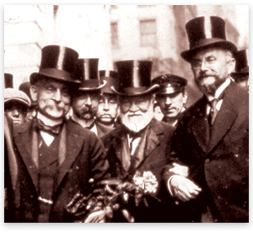
What to do about the corporations?
Break them up with anti-trust
Nationalize them
Let them continue with regulation
Destroy them altogether
Do nothing because corporations are, like, totally awesome.
We are your friends; please don’t hurt us.

Slide 18
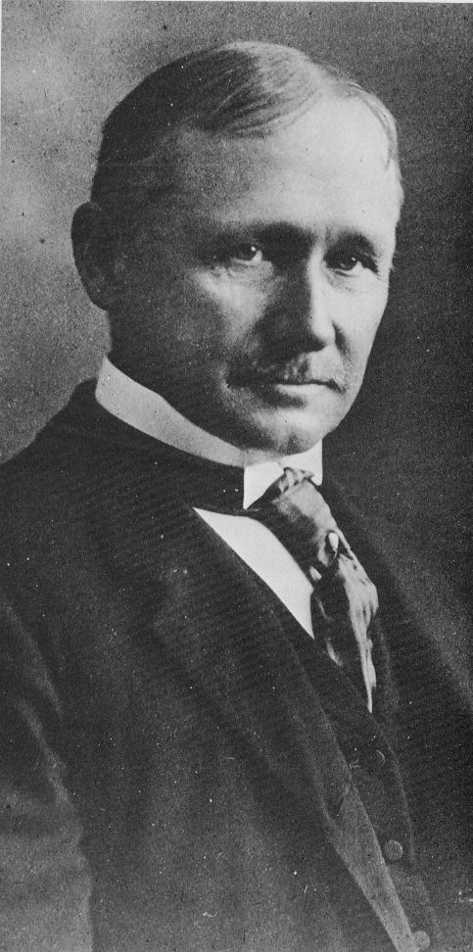
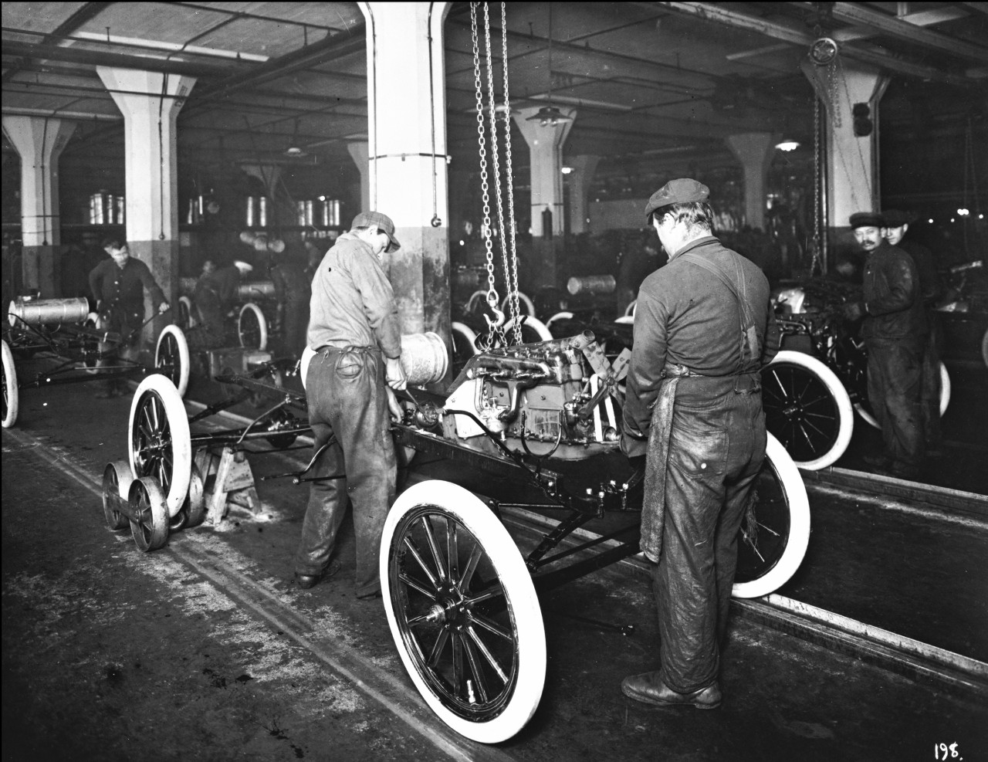
1911, F. Taylor wrote Principles of Scientific Management
Replace “rule of thumb” work methods with scientifically discovered principles
Train employees systematically
Write down all training procedures
Divide work between managers and workers: managers manage; workers do the work
A Ford assembly line, circa 1913

Slide 19
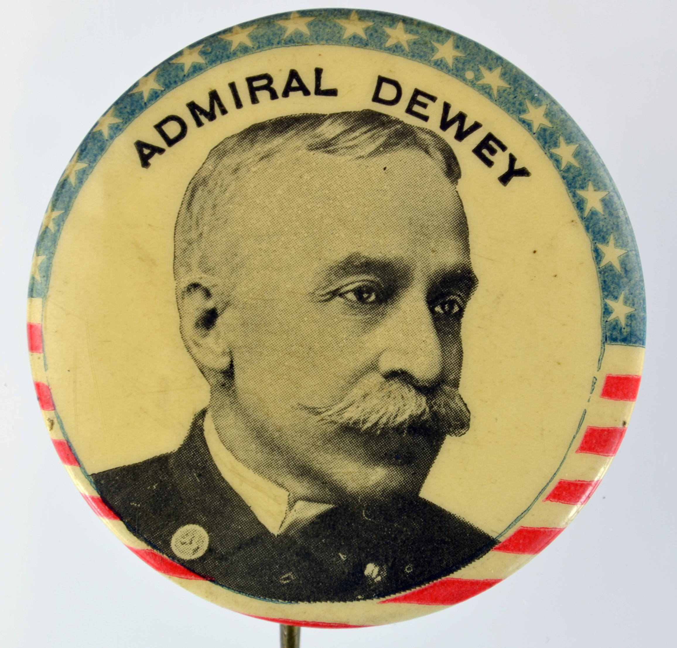
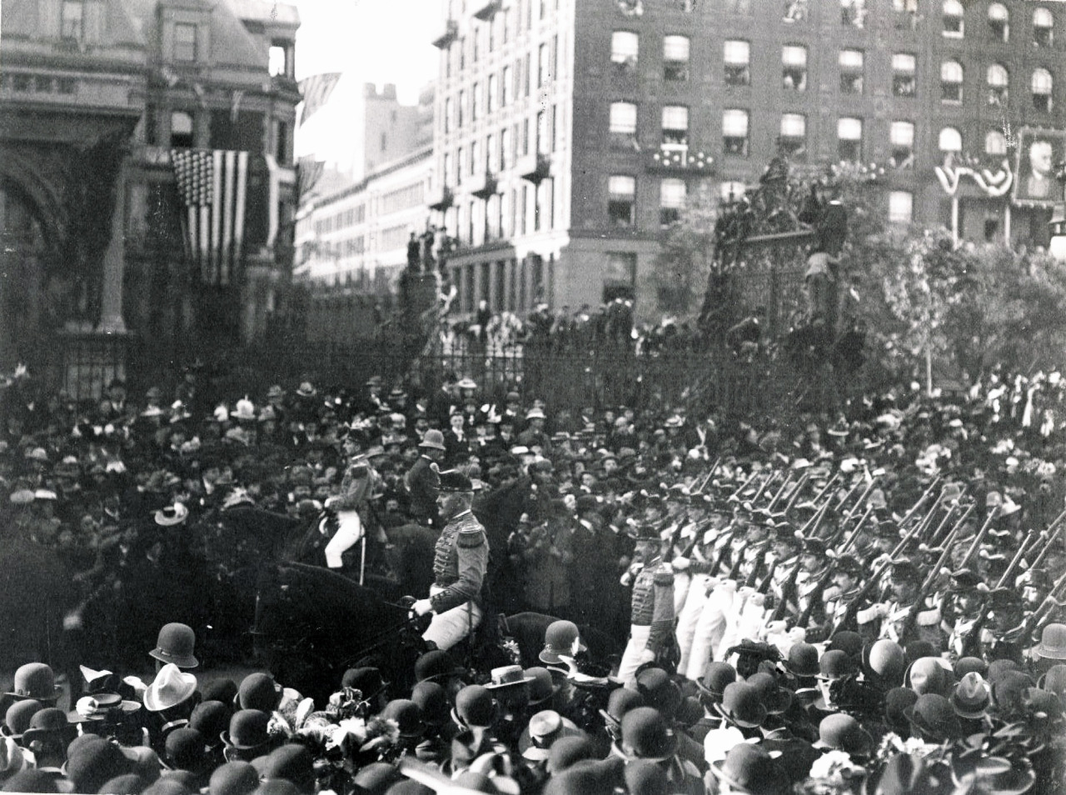

Slide 20
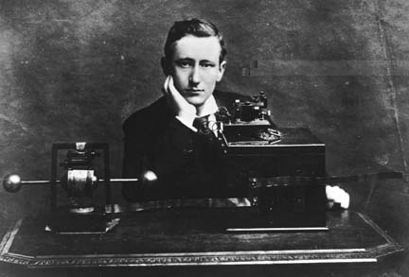
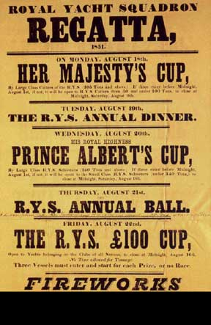
Marconi and the Yacht Race

Slide 21
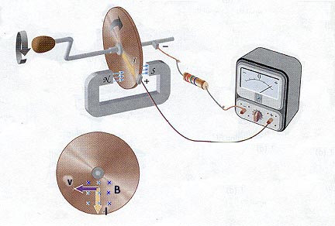
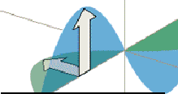
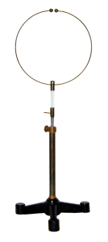
Faraday’s magnetic circuit
Maxwell’s light theory
Hertz wave device

Slide 22
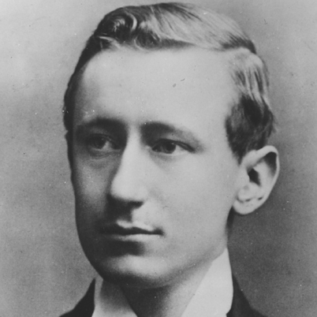
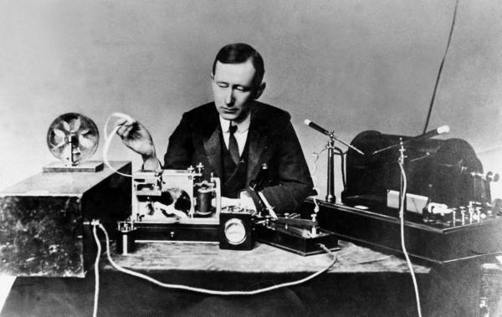

Slide 23
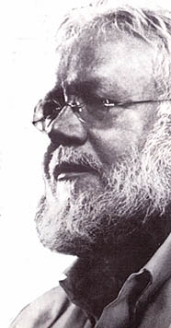
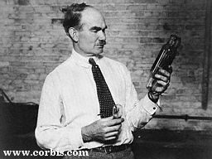
Lee De Forest and Reginald Fessenden

Slide 24
The Marconi business model
Don’t sell the equipment
Lease the service
Charge a regular, predictable rate for dependable wireless transmission service
Push notion that wireless is not just technology, but a “system”

Slide 25
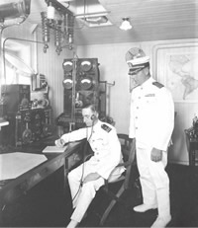
We don’t care; we don’t have to; we’re the Navy
We don’t care about paying you on time
We don’t care about your patents
We don’t care about your bottom line expenses
Nothing personal.

Slide 26
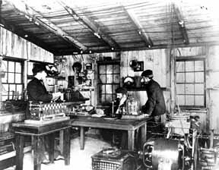
Fessenden’s Christmas radio broadcast, 1906

Slide 27
De Forest Fleming valve

Slide 28
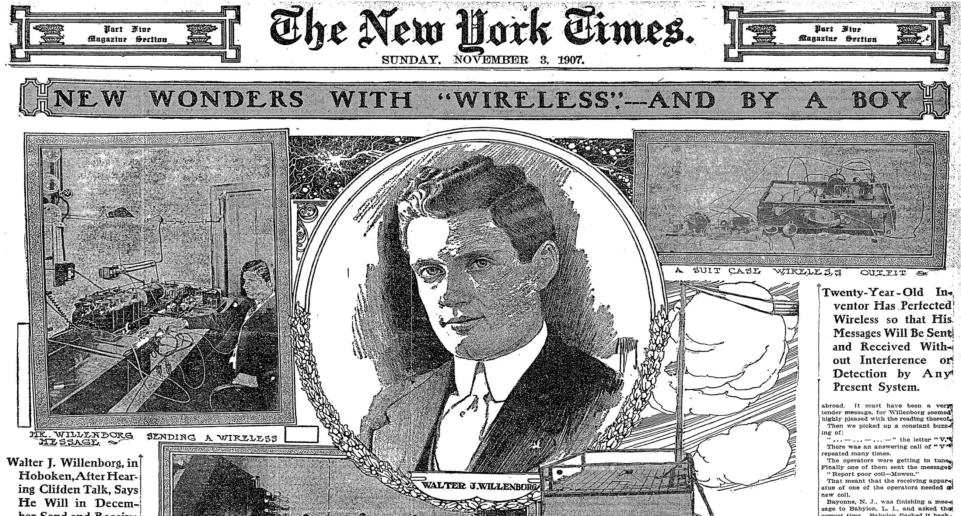

Slide 29
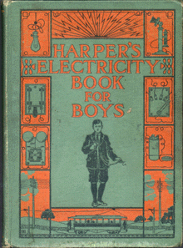
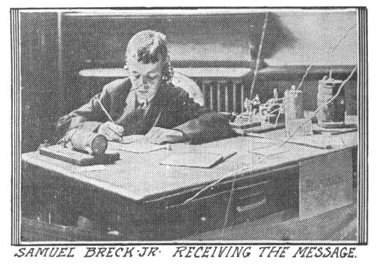
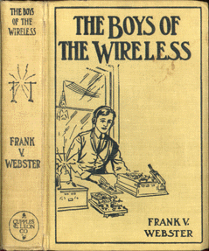
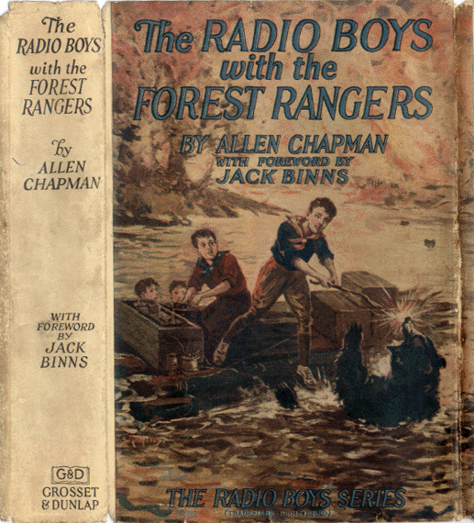
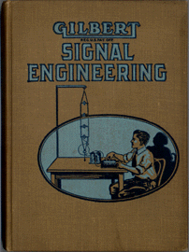

Slide 30
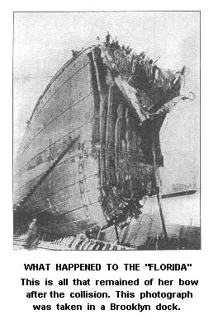
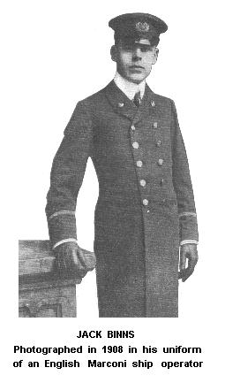

Slide 32
The Radio Act of 1912
Any "person, company, or corporation" using a radio transmitter must have a license
Issued by the Department of Commerce

Slide 33
The 1919 RCA Deal
Under pressure from Navy, British Marconi sells its American division
General Electric and American Marconi start a new corporation: The Radio Corporation of America
RCA sells and leases wireless equipment in the U.S., manufactured by G.E.
The deal establishes precedent: corporations will control broadcasting in the United States, with some oversight by the state

Slide 34
KDKA in 1920

Slide 35
AT&T’s power
AT&T had by 1913 bought out many independent telephone companies
Often by bribery or outright political influence
It also controlled Western Union Telegraph
Public began talking about nationalizing telephone service or breaking up AT&T

Slide 43
The compromise
1913: AT&T promises to stop preventing local exchanges from connecting to its national telephone network
Pledges not to acquire new exchanges without government permission
Federal government forbids telephone companies from owning radio stations
Federal government regulates broadcasters “in the public interest” via the Federal Communications Commission

Slide 44
Roosevelt triples national forest land to 150 million acres; right photo TR with John Muir at Yosemite

Slide 45
The “sewer socialists”
Like Cleveland Mayor Tom Johnson (above), they called for municipal ownership of gas, water, electricity, telephone, and other services.

Slide 46
Eugene Victor Debs becomes leader of Socialist Party of America, 1901

Slide 48
The Jungle published in 1906
Led to passage of the Meat Inspection Act and Pure Food and Drug Acts (of that year)

Slide 50
Eugene Debs and the Socialist Party
1908: Debs won 400,000 votes in his presidential bid
Almost 120,000 members in 1912
1,150 socialists held office in 36 states and 325 towns and cities
Eugene Debs ran for president in 1912 and 1920 and won almost a million votes

Slide 51
The Lawrence Massachusetts strike of 1912
Led by the Industrial Workers of the World
Multicultural immigrant strike

Slide 52
The Industrial Workers of the World
Advocated “anarcho-syndicalism”: a decentralized, stateless world run by unions (syndicato)
Advocated sabotage, although its members rarely actually followed through on this
Based in big western industries: lumber and mining, especially
William Haywood, wild eyed radical (accept no substitutes)

Slide 53
TR’s Progressive “Bull Moose” Party, 1912

Slide 54
TR’s “New Nationalism” vs. Wilson’s “New Freedom”
TR supportive of expansion of Federal government to regulate commerce and industry
Supported women’s suffrage, lower tariffs, graduated income tax
Supported policies that would protect small business, smaller cities, and the professions
Especially anti-trust
Suspicious of federal power
Sympathetic to “state’s rights” democrats

Slide 55
The Presidential Election of 1912
Democrat Woodrow Wilson (the winner): 42 percent of the vote
Progressive Roosevelt: 27 percent
Republican Taft: 23 percent
Socialist E.V. Debs: 6 percent!
. . . Distinctly leftward turn for American politics

Slide 57
Federal Income Tax, 1913
1895: Supreme Court declares Federal income tax unconstitutional
1913: Congress and the states ratify the 16th amendment, which gave Congress the right to levy direct taxes
1913: Congress puts 1 percent tax on individual and corporate incomes over 4,000 a year

Slide 58
The Federal Reserve System created on December 23, 1913
Board of Governors appointed by the President (of the United States) in consultation with Senate
The Chair and Vice Chair named by the President
Individual banks belong to 12 regional banks and keep some of their money in the regional banks
The Federal Reserve lends money to banks at the Prime Rate, determined by the Board of Governors

Slide 59
The Clayton Act, 1914
Bolsters the Sherman Anti-Trust Act
Specifically listed trade practices that were unlawful (so they couldn’t be called “manufacturing” practices)
Prohibited “interlocking directorates” in corporations
Unions could not be enjoined when “acting legally.”

Slide 60
Federal Trade Commission, 1915
Investigates unfair trade practices and unfair methods of competition
Begins crusade for “truth in advertising”
Monopoly, est. 1935

