Slide 1
Welcome to History 110f
The United States from
1914 to 1945
Wirevicus.com

Slide 2
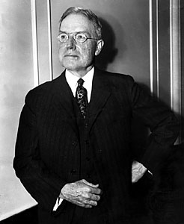
John Rockefeller Jr.
“The growth of a large business is merely the survival of the fittest. It does the greatest good to the greatest number, although perhaps at the expense of the few . . . It is merely the working out of a law of God and nature.”

Slide 3
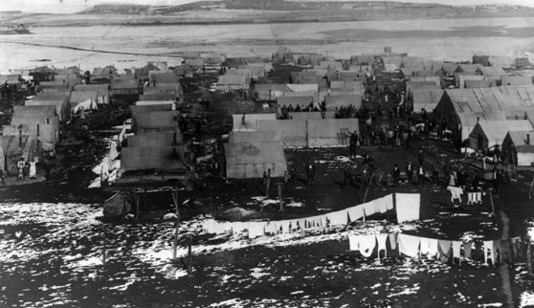
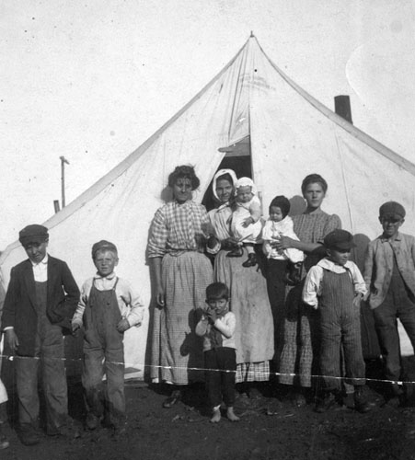
Ludlow Colorado, 1914

Slide 4
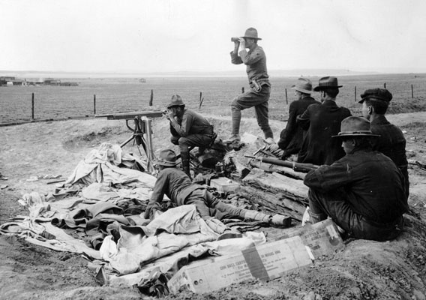
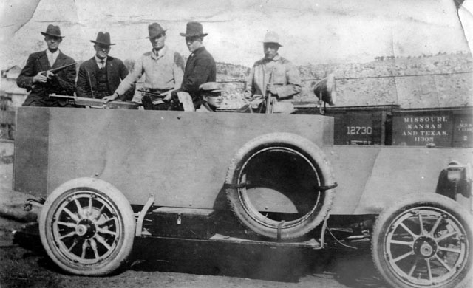
Ludlow state militia
The “Death Special”

Slide 5
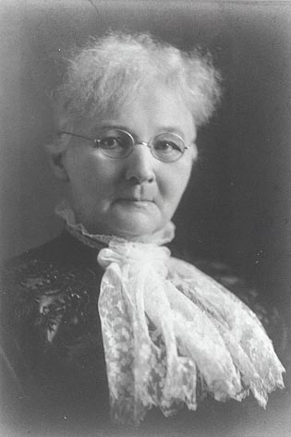
Mother Jones (Mary Harris Jones)
“Whatever you fight, don’t be ladylike.”

Slide 6
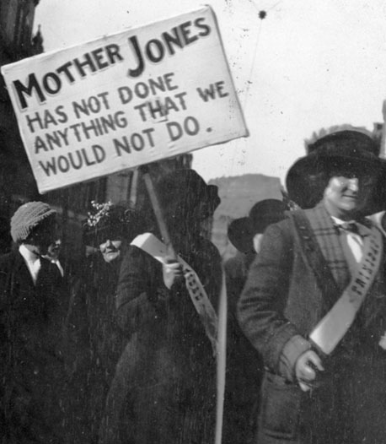
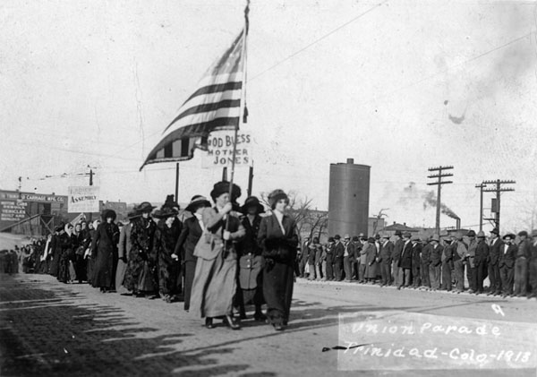

Slide 7
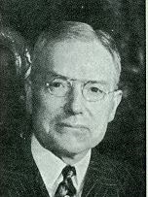
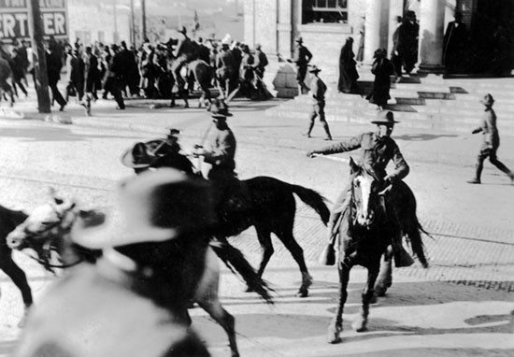

Slide 8
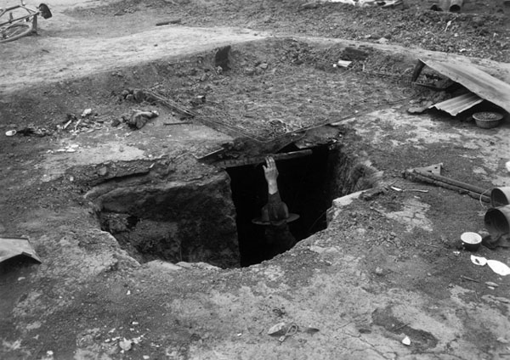
The “Death Pit” of Ludlow, Colorado

Slide 9
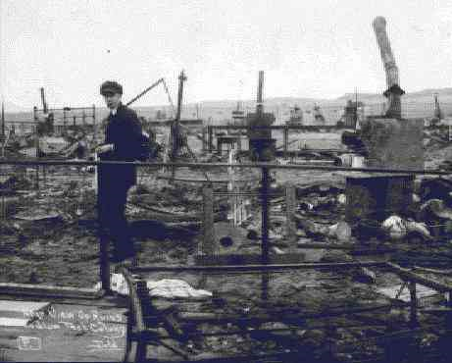
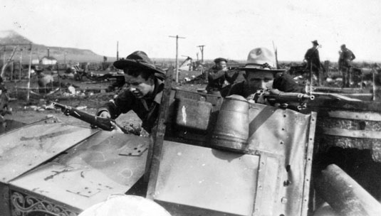
The Ruins of Ludlow

Slide 10
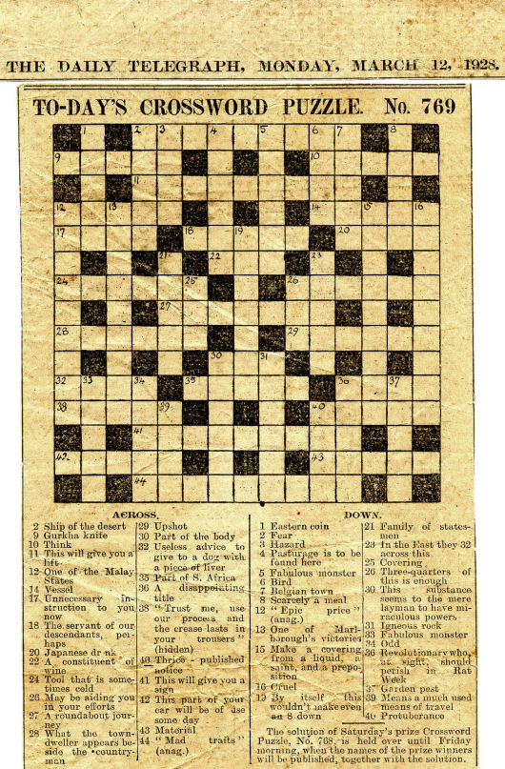
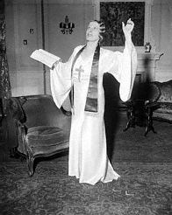
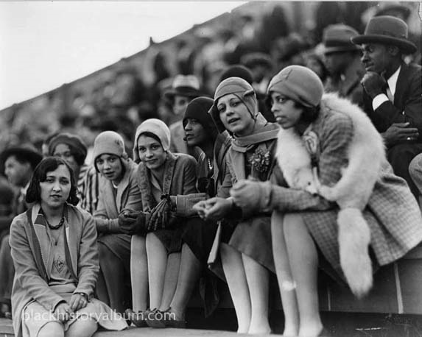
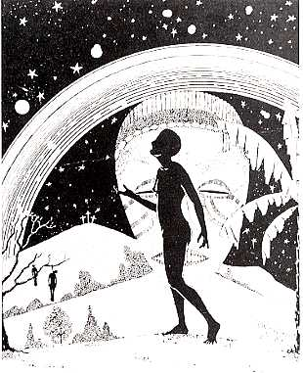
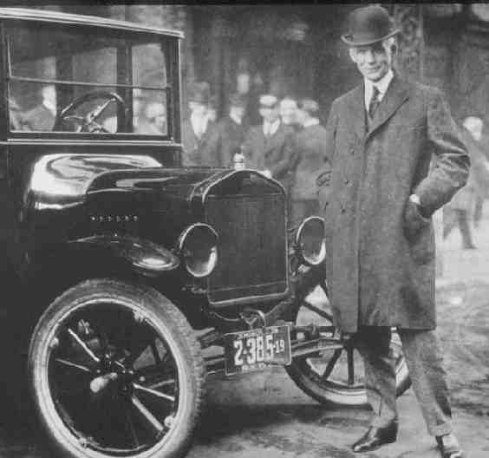
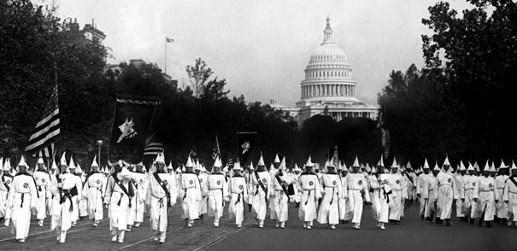

Slide 11
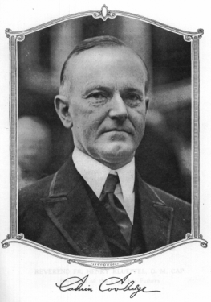
requirements
Mid-term and final
Five section response papers
Term paper
Section attendance
Two quizzes

Slide 12
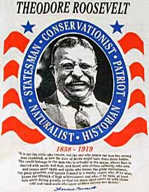
“The true friend of property, the true conservative, insists that property shall be the servant and not the master of the commonwealth . . . “

Slide 13
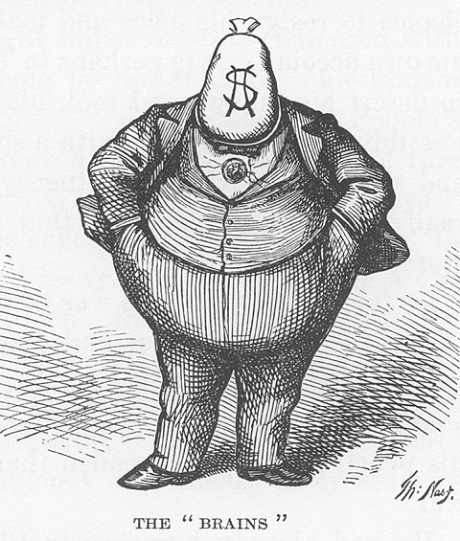
What is capitalism?
“An economic system in which the means of production and distribution are privately or corporately owned and development is proportionate to the accumulation and reinvestment of profits gained in the market.”

Slide 14
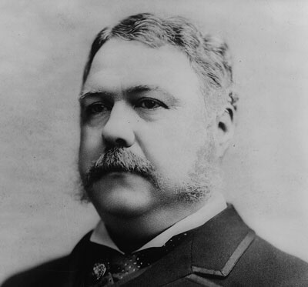
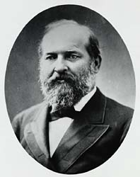
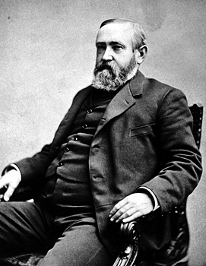
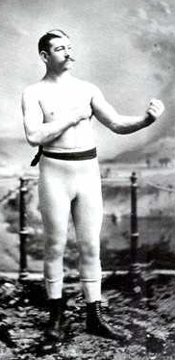
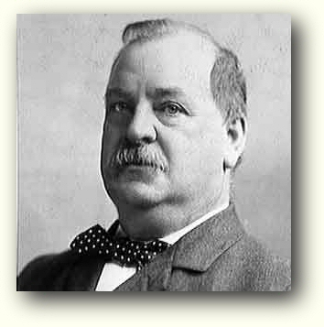
The Victorian United States
A partisan political system
An extremely ethnically fragmented decentralized, society
A weak state
Unstable, boom and bust economy
Modern corporation becomes dominant economic form

Slide 15
U.S. per capital economic growth, 1850-1919
 | population | per capita income
1880 | 50 million | 206 million | 4 dollars a year
1919 | 106 million | 804 million | 8 dollars a year
The wealthiest one percent of families in 1890 owned 51 percent of all real and personal property.
The 44 percent least wealthy households owned only 1.2 percent of all property.
Together, the wealthy and better off upper middle class (about 12 percent) owned 86 percent of all wealth.

Slide 16
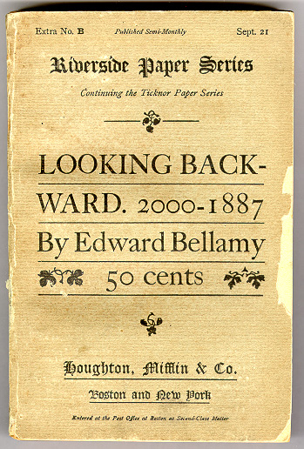
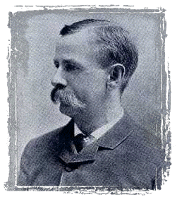

Slide 17
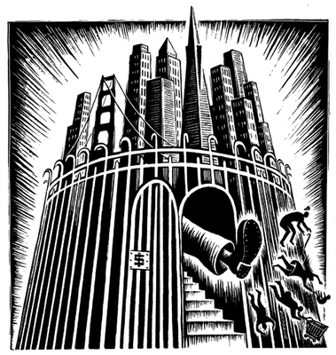
In defense of the realm:
Social Darwinism: Society should reflect “nature’s” system of “survival of the fittest.”
Malthusianism: Famines were a natural system of weeding out the weak
democratic arguments
Turnerism: Individualism part of the American character

Slide 18
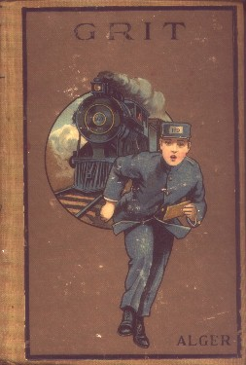
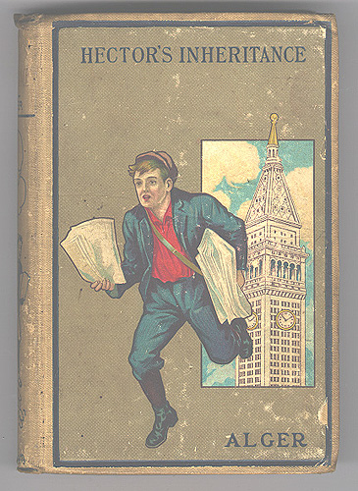
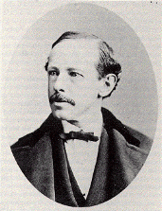
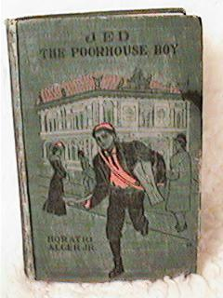
Horatio Alger

Slide 19
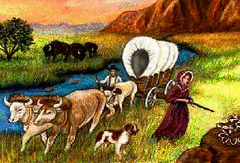
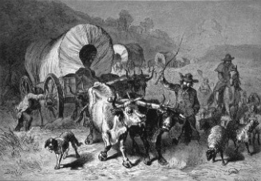
The wilderness masters the colonist. It finds him a European in dress, industries, tools, modes of travel and thought. . . .
. . . . It takes him from the railroad car and puts him in the birch canoe. It strips off the garments of civilization and arrays him in the hunting shirt and the moccasin.

Slide 20
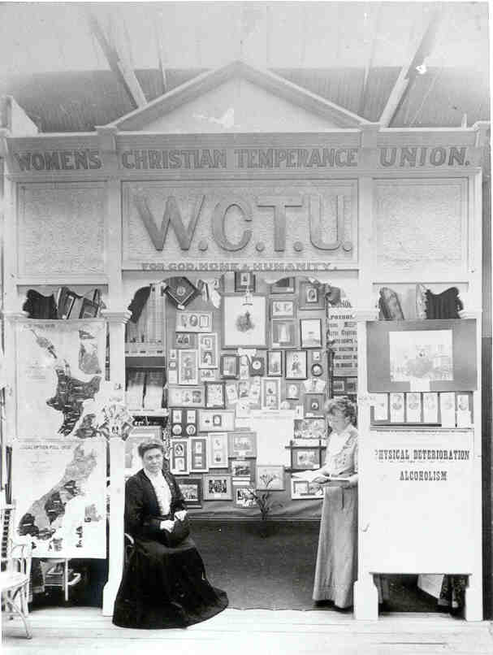
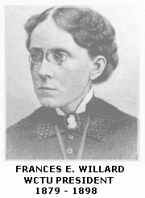
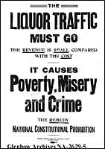

Slide 21
The Great Railroad Strike of 1877

Slide 22
The Paris Commune, 1871

Slide 23
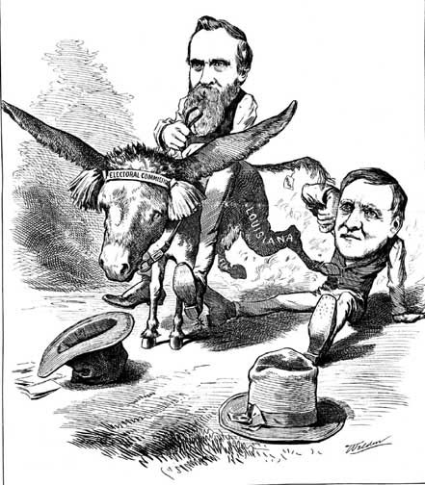
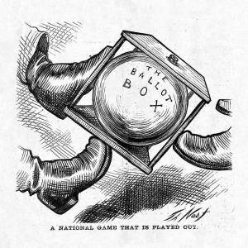
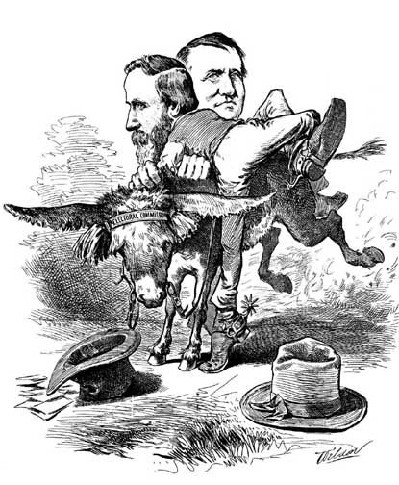
The “Stolen Election” of 1876

Slide 24
Why farmers didn’t like the Gold Standard . . .
Imagine a world in 1880 with 1 farmer, 1 bushel of wheat to sell and 1 consumer with 1 dollar?
Q. How much is that bushel going to sell for?
(A. 1 dollar)
Suppose in 1881 the population goes up . . .
Now there are 2 farmers and 2 bushels of wheat being sold to 2 consumers.
But, still only one dollar because the dollar is based on the extant supply of gold!
Q. How much do those two farmers get for their wheat?
Still one crummy buck, which the two farmers have to divide among them! ☹

Slide 25
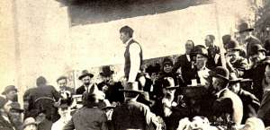
The People’s Party, 1892
Calls for government warehouses to store crops and loan money to farmers at fair rates
Direct primaries
Progressive income tax
Direct election of senators
An alliance meeting in the 1880s

Slide 26
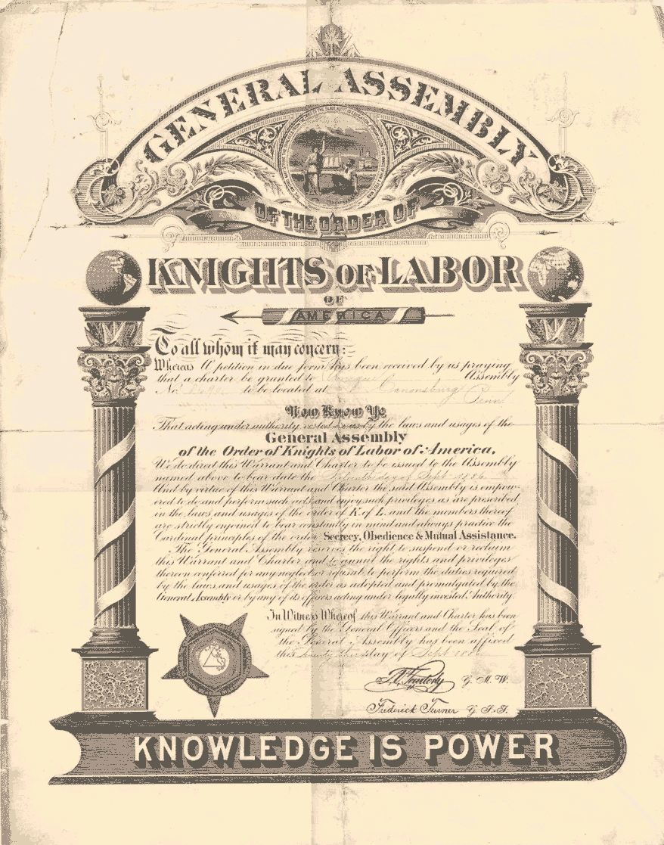
Knights of Labor
Organized themselves around “assemblies” of workers
Sought to challenge the wage system

Slide 27
Henry George’s economic analysis
As civilization advances, labor saving devices proliferate
Industrial progress leads to overproduction, depressions become endemic
Solution? THE SINGLE TAX! A tax on unused land or speculated land
The government has revenue for social needs!
Extra land for agrarian settlement

Slide 28
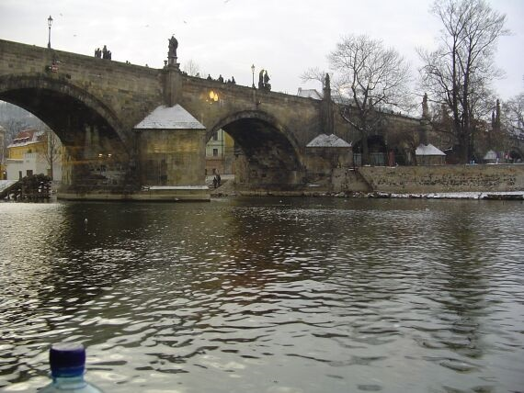
Rise of the Modern Corporation
West River Bridge (1848): Eminent domain opens up land and resources to industry
Dartmouth College (1816) and Charles River Bridge (1837) free corporations from state regulation
Limited Liability frees capital from social responsibility
Santa Clara (1886) defines corporation as an individual
New Jersey and Delaware make it easy for corporations to register with little state oversight

Slide 29
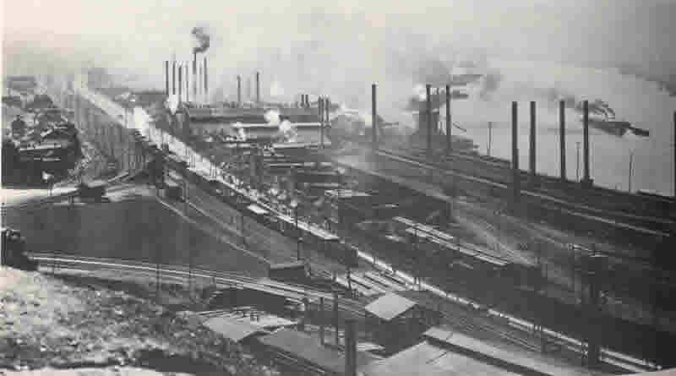
U.S. Steel, 1901
First billion dollar U.S. Corporation
11 companies
800 plants
Controlled 60 percent of all steel output in the U.S.

Slide 30
The American Federation of Labor (AFL)
Founded in 1886 by Samuel Gompers
A coalition of craft unions

Slide 31
May 3, 1886 Haymarket Square, Chicago

Slide 32
The American Federation of Labor (AFL)
Gompers advocates “pure and simple” trade unionism
“Pure” because AFL stayed out of politics
“Simple” because AFL organized only skilled workers
1 million members by 1901 . . .

Slide 33
Immigration to the U.S., 1871-1900
 | 1871-1880 | 1881-1890 | 1891-1900 | 1901-1910
From Europe | 2,274,874 | 4,783,413 | 3,655,673 | 8,175,296
From Asia | 123,803 | 65,380 | 71,236 | 243,567
From the Americas | 404,044 | 425,967 | 38,972 | 361,888
From everywhere | 2,814,793 | 5,292,259 | 3,794,259 | 8,832,666

Slide 34
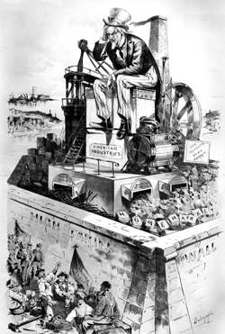
The Tariff
Republicans say tariff good for industry and workers
Democrats say its bad for farmers and consumers.
An anti-tariff cartoon from a Democratic party paper

Slide 35
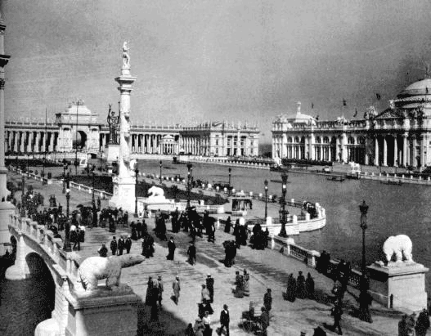
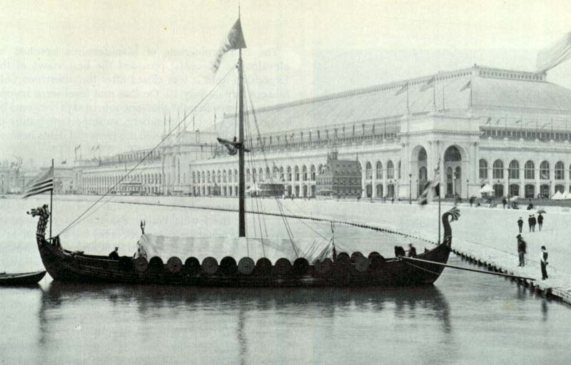
No sooner did the Chicago Columbian Centennial of 1893 conclude than the Depression of the 1890s began

Slide 36
Coxey’s Army, 1893

Slide 37
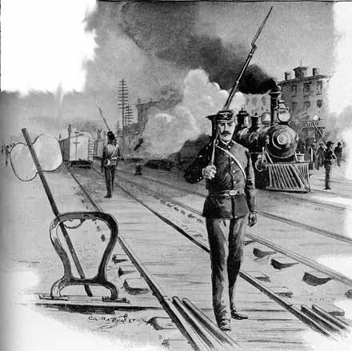
The Pullman Strike, 1894
Strike collapses communications and economy of the entire eastern United States well into and past Chicago. First serious effort of industrial unionism to flex its muscle.

Slide 38
Bryan’s 1896 political program
A graduated Federal income tax
Direct election of United States Senators
Greater regulation of the railroads, telegraph, and monopolies to protect consumers
Lower tariffs to protect consumers
Backing the dollar with silver as well as gold for a more flexible currency

Slide 39
Tom Watson of the People’s Party
William Jennings Bryan, “Cross of Gold” speech, 1896
Election of 1896: McKinley beats Bryan, 51 to 46.7 %
Republican William McKinley

Slide 40
$tate department, 1898: We need new market$!
“It seems to be conceded that every year we shall be confronted with an increasing surplus of manufactured goods for sale in foreign markets if American operatives and artisans are to be kept employed the year around. The enlargement of foreign consumption of the products of our mills and workshops has, therefore, become a serious problem of statesmanship as well as of commerce.”

Slide 41
Progressivism
Emphasis on pragmatic, non-ideological reform
Called for more direct, democratic government
Accepted the corporation as a fact of life to be regulated and managed
Did not establish safety net reforms
Jane Addams and John Dewey

Slide 42
Federal Income Tax, 1913
1895: Supreme Court declares Federal income tax unconstitutional
1913: Congress and the states ratify the 16th amendment, which gave Congress the right to levy direct taxes
1913: Congress puts 1 percent tax on individual and corporate incomes over 4,000 a year

Slide 43
The Federal Reserve System created on December 23, 1913
Chair, Vice Chair, and Board of Governors appointed by the President (of the United States)
Individual banks belong to 12 regional banks and keep some of their money in the regional banks
The Federal Reserve lends money to banks at the Prime Rate, determined by the Board of Governors

Slide 44
The Clayton Act, 1914
Specifically listed trade practices that were unlawful (so they couldn’t be called “manufacturing” practices)
Prohibited “interlocking directorates” in corporations
Unions could not be enjoined when “acting legally.”

Slide 45
Federal Trade Commission
Investigated unfair trade practices
Unfair methods of competition
1959: Federal Trade Commission waged a 15 year campaign to get the makers of Geritol to stop saying that it cured “iron poor tired blood,” which it didn’t.
1950s: Companies that manufactured “little liver pills” admitted to the FTC that the pills had no impact on the human liver.
Phishing videos

Slide 46
Limits of progressivism
Absence of
Welfare state provisions
Oversight of the financial sector (particularly the stock market)
Public investment
Explicit recognition of unions
Racism

