Slide 2
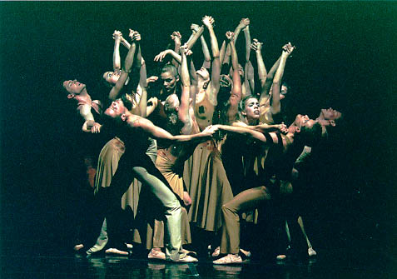
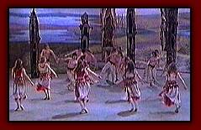
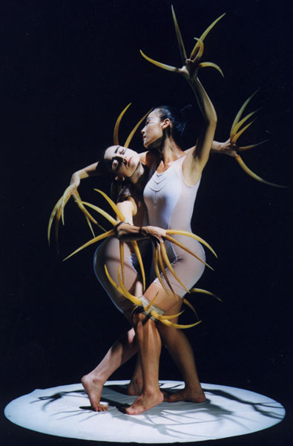

Slide 3
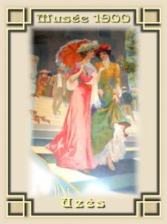
La Belle Epoque (“The Beautiful Time”) 1877-1914

Slide 4
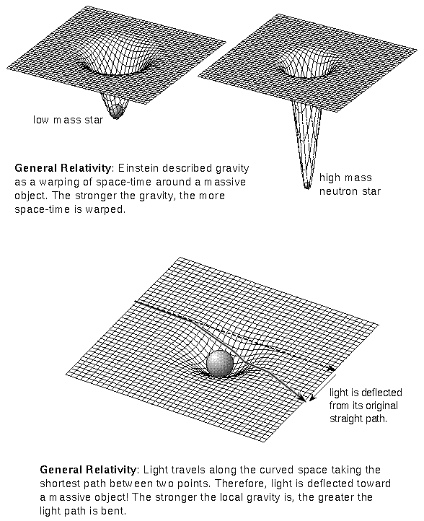
Einstein’s discoveries of “relativity,” 1905-1915
Matter and energy interchangeable
Light and time can be “diverted” by gravity
Newton’s laws function differently in the cosmos than in ordinary life

Slide 5
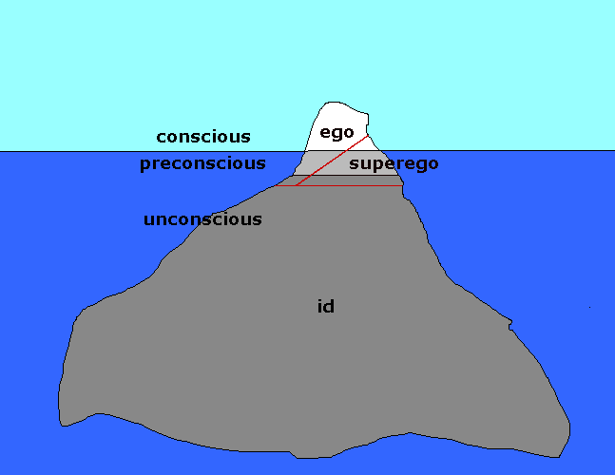
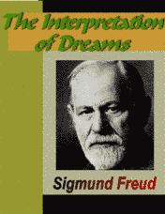
Freud’s unconscious (1899)
The portion of our mind where we hold repressed, desires, memories, motivations, and feelings.
Manifests itself in dreams, slips of the tongue, and various levels of irrational and hystical behavior

Slide 6
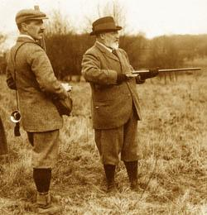
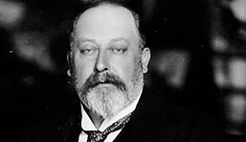
The Edwardian Era
Edward the VIIth offered the example of a much more pleasure centered style than his mother, Queen Victoria

Slide 7
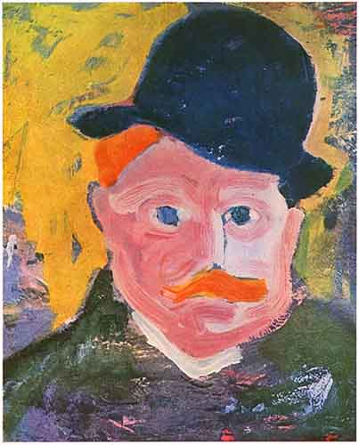
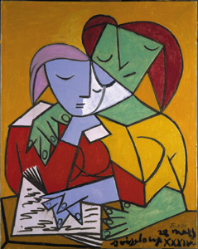
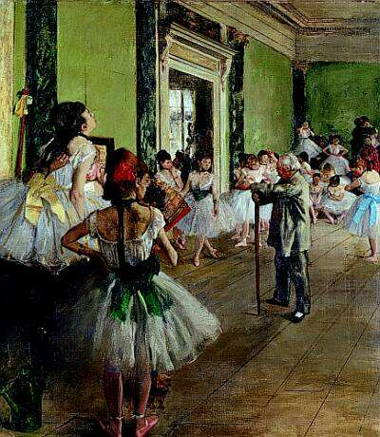
Picasso the Cubist, Vlaminck the Fauve, Degas the impressionist

Slide 8
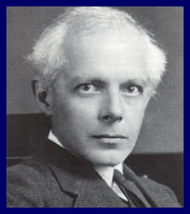
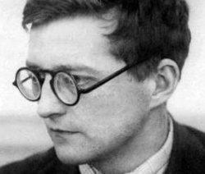
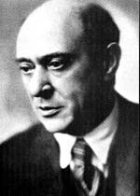
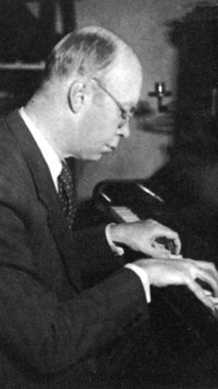
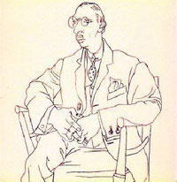
Modernist composers
Sergei Prokofiev, Bela Bartok, Igor Stravinsky, Dimitri Shostakovitch, Arnold Schoenberg

Slide 9
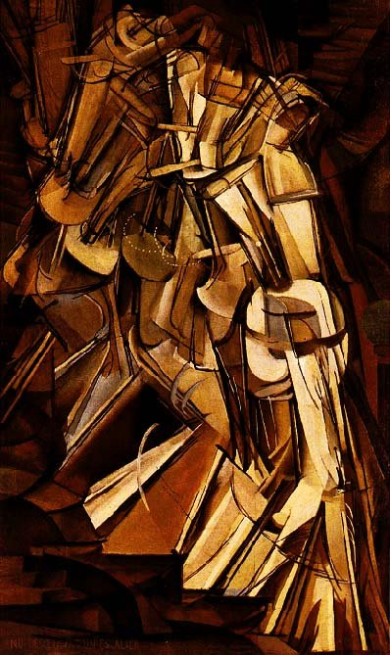
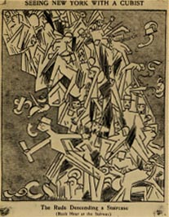
The Armory Show, 1913
Duchamp, Nude Descending a Staircase

Slide 10
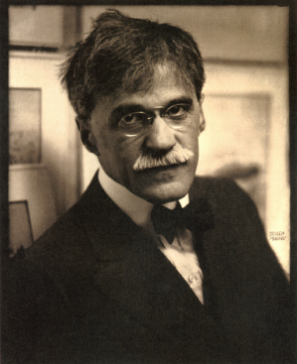
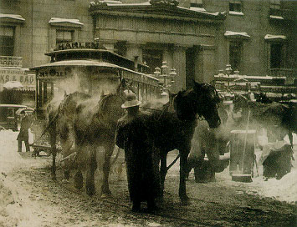
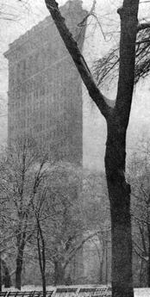
Revolution in photography
Alfred Steiglitz

Slide 11
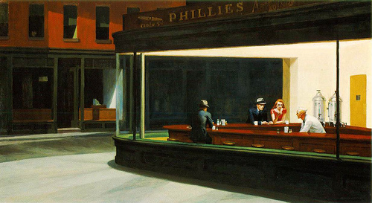
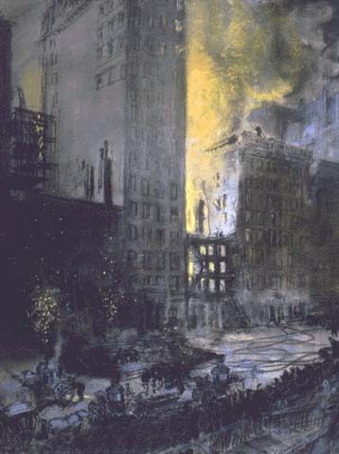
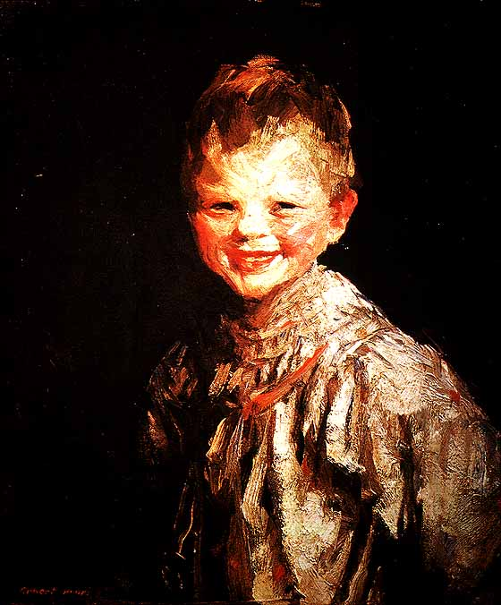
The Ashcan painters
Robert Nashville, Fire on 24th Street; Hopper, Nighthawks; Henri, Laughing Child

Slide 12
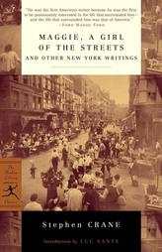
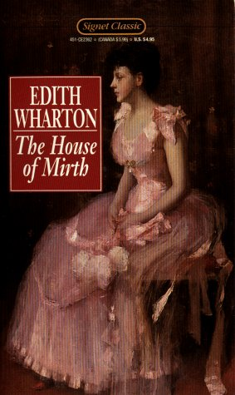
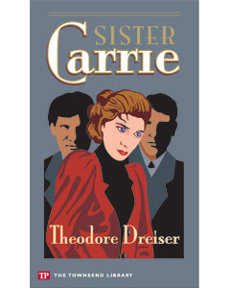
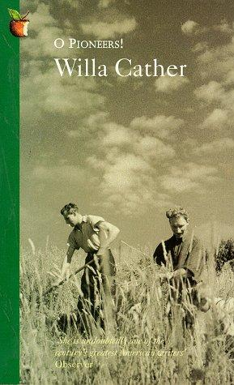
The new “realist’ novel

Slide 13
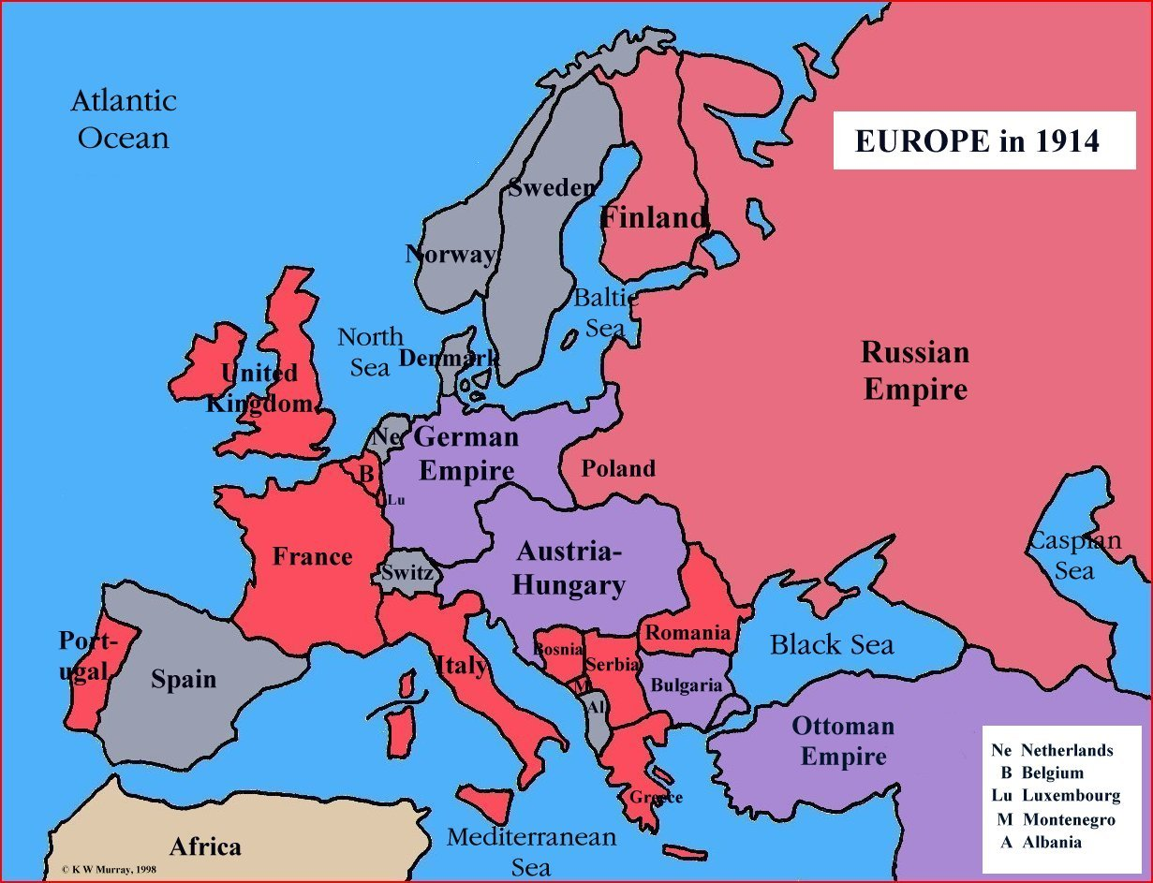
The Triple Entente: England, France, and Russia
Germany and the Austro-Hungarian Empire

Slide 14
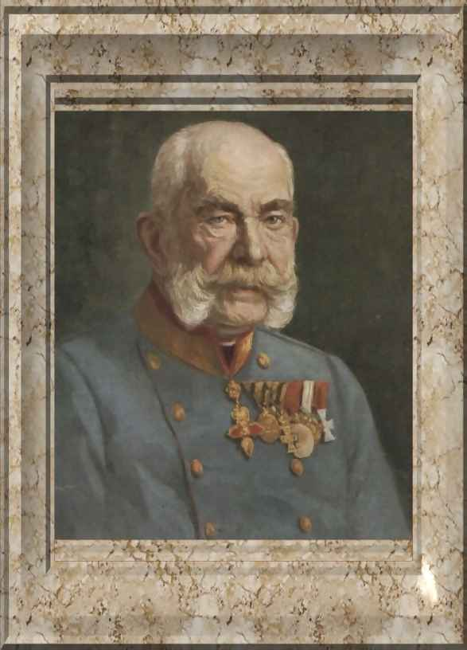
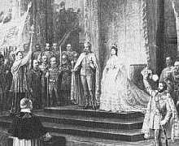
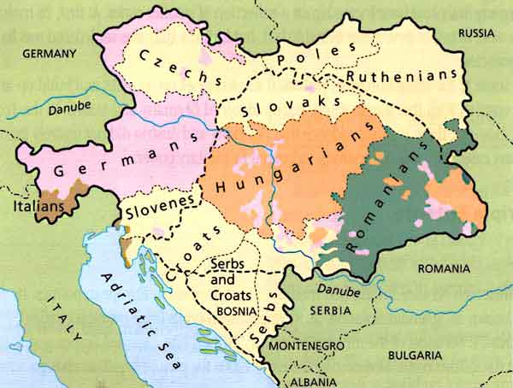
Emperor Franz-Joseph of the Austro-Hungarian Empire

Slide 15
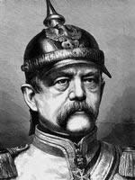
, “The great questions of the day will not be decided by speeches and the decisions of a parliamentary majority…but by iron and blood.”
--Otto Von Bismarck

Slide 16
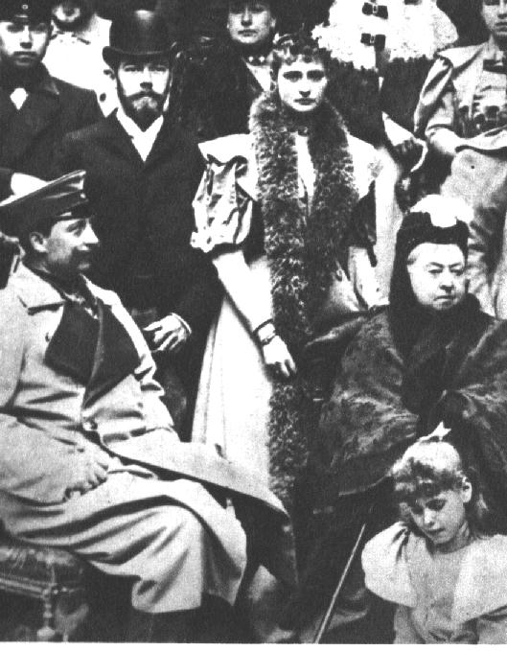
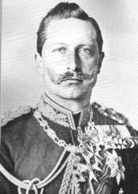
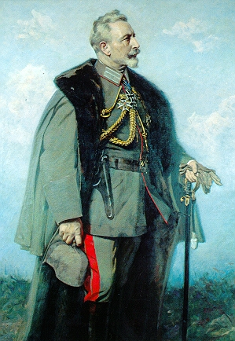
King George IV and Nicholas II
Princess Alexandra
Queen Victoria
Kaiser Wilhelm of Germany.

Slide 17
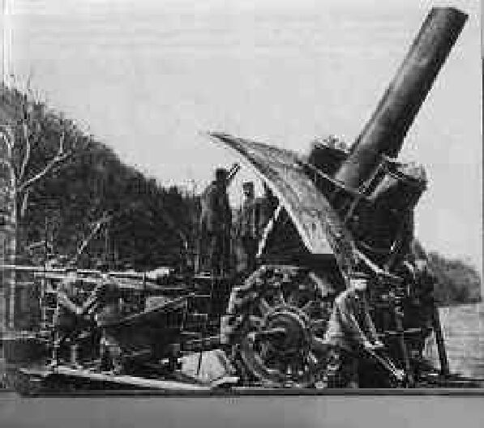
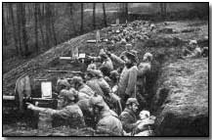
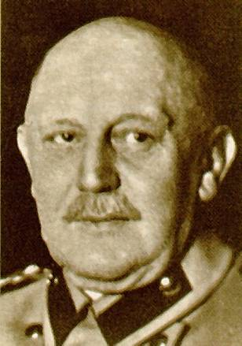
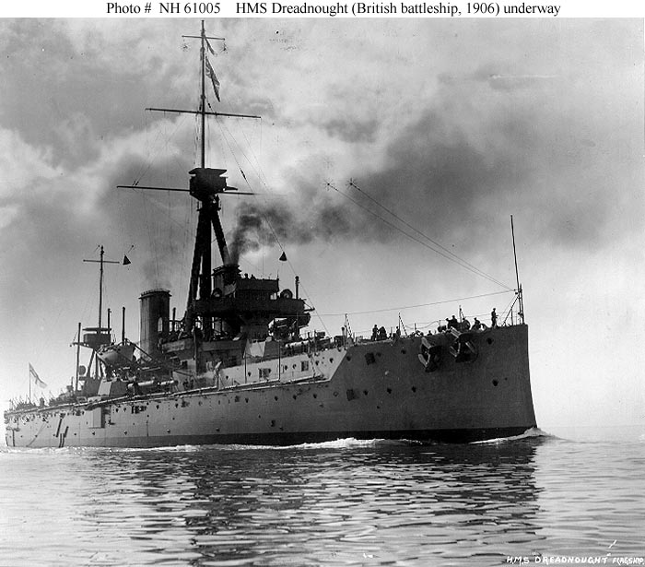

Slide 18
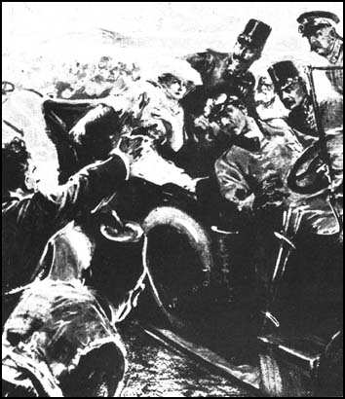
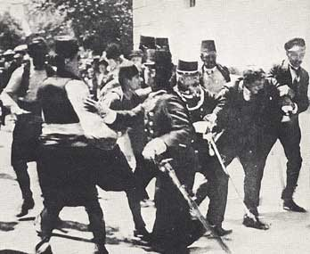
1914: Archduke Francis Ferdinand and his wife are assassinated in Sarajevo.

Slide 19
“July 31, 1914: It is technically impossible to stop our military preparations which were obligatory owing to Austria's mobilization. We are far from wishing war. . . .
I put all my trust in Gods mercy and hope in your successful mediation in Vienna for the welfare of our countries and for the peace of Europe.
Your affectionate Nicky.”

Slide 20
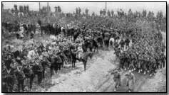
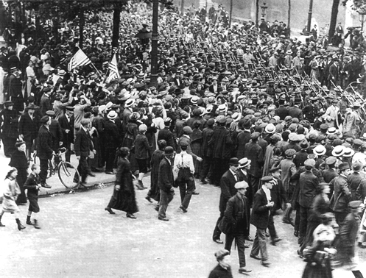
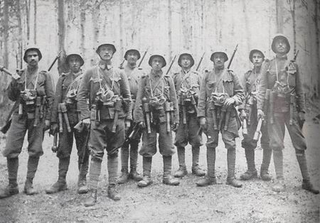

Slide 21
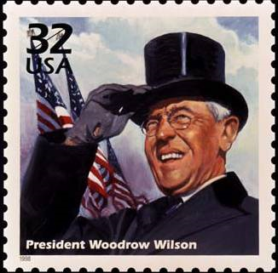
Oversaw creation of Fed reserve, Federal Trade Commission, income tax
Internationalist and interventionist; anglophile
South white supremacist

Slide 22
U.S. trade with Europe during the First World War
With the Central Powers (Germany and Austro-Hungarian empire): 1914: 169 million dollars 1916: down to 1 million dollars
With the Allies (England, France): 1914: 825 million dollars 1916: up 3 thousand million dollars! (otherwise known as 3 billion)

Slide 23
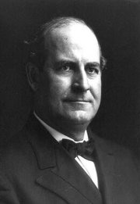
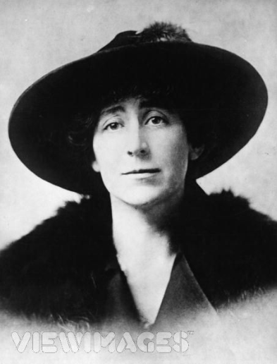
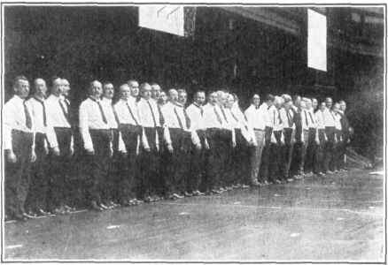
Bryan quit as Secretary of State rather than be part of the war
Congressmember Jeannette Rankin opposed World War I
“Preparedness marches” spread across the United States

Slide 24
war questioners
intellectuals: are England and France really superior to Germany?
pacifists
Irish-Americans
German-Americans
socialists
Civil War veterans
populists
H.L. Mencken questioned getting into the war

Slide 26
The Committee for Public Information
Founded April 13, 1917
Six pounds of paper with “facts” about the war sent per day to newspapers
Produced pro-war propaganda for a wide variety of constituents

Slide 27
German = Hun

Slide 28
The Espionage Act of June 15, 1917
“Whoever, when the United States is at war, shall willfully make or convey false reports or false statements with intent to interfere with the operation or success of the military . . . [etc] shall be punished by a fine of not more than $10,000 or imprisonment of not more than 20 years, or both . . . “
“Every letter, writing, circular, postal card, picture, print . . . in violation of this act is hereby declared to be non-mailable matter . . . “ and subject to fines of $5,000 dollars or up to five years in prison

Slide 29
The Trading with the Enemy Act October 6, 1917
If you publish an article in a foreign language about the war, you’ve got to file with the postmaster a true translation of the article
If you don’t, your publication will be declared un-mailable.

Slide 30
The Sedition Act of May 16, 1918 (an amendment to the Espionage Act)
. . . or to promote the success of its enemies, or shall willfully make or convey false reports, or false statements, ...or incite insubordination, disloyalty, mutiny, or refusal of duty, in the military or naval forces of the United States, or shall willfully obstruct ...the recruiting or enlistment service of the United States, or ...shall willfully utter, print, write, or publish any disloyal, profane, scurrilous, or abusive language about the form of government of the United States, or the Constitution of the United States, or the military or naval forces of the United States ...or shall willfully display the flag of any foreign enemy, or shall willfully ...urge, incite, or advocate any curtailment of production ...or advocate, teach, defend, or suggest the doing of any of the acts or things in this section enumerated and whoever shall by word or act support or favor the cause of any country with which the United States is at war or by word or act oppose the cause of the United States therein . . .
SECTION 3. Whoever, when the United States is at war, shall willfully make or convey false reports or false statements with intent to interfere with the operation or success of the military or naval forces of the United States . . . . . . shall be punished by a fine of not more than $10,000 or imprisonment for not more than 20 years, or both....

Slide 31
American Protective League badge, Eugene Debs, Frank Little

Slide 32
Sedition panic in Montana www.seditionproject.net
79 people incarcerated for “sedition” – 1917-1919
"Whenever the United States shall be engaged in war, any person or persons who shall utter, print, write or publish any disloyal, profane, violent, scurrilous, contemptuous, slurring or abusive language about the form of government of the United States, or the constitution of the United States, or the soldiers or sailors of the United States, or the flag of the United States, or the uniform of the army or navy of the United States…or shall utter, print, write or publish any language calculated to incite or inflame resistance to any duly constituted Federal or State authority in connection with the prosecution of the War…shall be guilty of sedition. -- Montana State Law"

Slide 33
But professor . . .
What about The First Amendment of the Constitution?

Slide 34
Repressive precedents
Sedition act of 1798: made it a crime to utter false statements with an intent to defame
Lincoln suspends habeas corpus during Civil War
1868, Regina v. Hicklin (UK), unlawful to corrupt the minds of the weak with dangerous literature
1871, Comstock Act (US), empowers postmaster to seize obscene materials in the mails (including literature about birth control)

Slide 35
Schenck vs. United States, 1919
Charles Schenck caught circulating leaflets opposing the draft.
Supreme Court declares that in wartime there are different First Amendment rules than in peacetime.
"Words which, ordinarily and in many places, would be within the freedom of speech protected by the First Amendment may become subject to prohibition when of such a nature and used in such circumstances as to create a clear and present danger that they will bring about the substantive evils which Congress has a right to prevent. The character of every act depends upon the circumstances in which it is done.“ –Oliver Wendell Holmes

Slide 36
The Railroad Administration, 1917
Headed by banking/railroad insider William G. MacAdoo
Practical carte blanche to run the railroads
Could countermand any shipping order on any freight train
Could set wage levels
Could not be prosecuted by the Sherman Anti-Trust Act

Slide 37
War economy measures
Raised federal income taxes to 22.3 for 50k and over in annual income
Used Federal Reserve to sell war bonds
Created War Industries Board (WIB)
Created Council of National Defense as research arm of WIB
National Defense Advisory Commission organized business committees to study various businesses
Headed by “Dollar a year” men

Slide 38
The War Industries Board (WIB)
WIB: Industrialists and government officials, who met to assess the nation’s needs during the war
Council of National Defense did research on war needs

Slide 39
Ways WIB had to get industry to go along with war needs
Threaten to seize plants
Give uncooperative industries bad publicity
Refuse to cooperate with uncooperative businesses

Slide 40
Labor supports World War I
AFL calls on unions not to strike during war
In exchange unions get recognition
War workers get government housing
States pass worker safety laws
. . . and child labor laws

Slide 41
Booker T. Washington vs. W.E.B. DuBois
Washington preached self-help for African Americans
Urged them to stay out of politics
Urged them to pursue useful trades.
DuBois urged blacks to get into politics.
. . . . and to pursue higher education.

Slide 42
DuBois supports World War I
“Let us while this war lasts, forget our special grievances and close our ranks shoulder to shoulder with our white fellow citizens and the allied nations that are fighting for democracy.”

Slide 43
Members of the 369th Infantry division, “the Harlem Hellfighters” and their leader Sgt. Henry Johnson

Slide 45
“It is a risk, a danger to a country like ours to send 1,000,000 men out of the country who are loyal and not replace those men by the loyal values of the women they have left at home.”
Carrie Chapman Catt

Slide 46
The Social Purity Movement of the late-19th, early 20th-century
Temperance and prohibition reform
Anti-prostitution campaigns
The Vice-Society movement
Nativism
Pacifism

Slide 47
The “Comstock” Act of 1871
“Act of the Suppression of Trade In, and Circulation of, Obscene Literature and Articles of Immoral Use”
Prohibits sending of obscene literature through the mails
Defines birth control information as obscene
Comstock appointed assistant postmaster to enforce the law
Anthony Comstock

Slide 48
World War I educational literature instructed U.S. soldiers on how to tell the difference between a “good” European woman (left) and a “bad” one (right). Contact with both was discouraged.

Slide 49
Walter Lippman thought he could influence the war’s direction.
Randolph Bourne thought the war make the state too powerful and discouraged critical thinking.
Philosopher John Dewey supported the war because he thought he could have a greater influence on government.

Slide 50
James McKeen Cattell
Charles Beard
Nicolas Murray Butler

Slide 52
New York Draft Riots of 1863

Slide 53
Post-Traumatic Stress Disorder
WWII: Battle Fatigue
WWI: “war neurosis”
Or “Shell Shock”

Slide 54
Social precedents of World War I
attempts to motivate people via volunteer services
regulatory agencies that would coordinate the private sector
agencies that would coordinate lending in the banking sector
the use of propaganda to gain public support for these services
the tapping of business executives to head these agencies
the tapping of intellectuals, especially from the academy, to formulate and evaluate policy
partnership with conservative unions to gain labor support for government efforts

