Slide 1
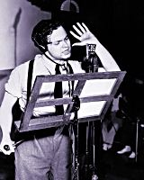
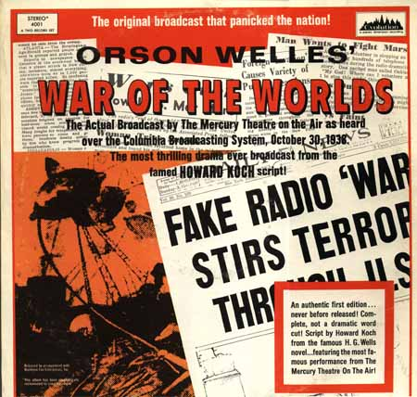

Slide 2
FDR’s 1937 Court packing scheme
1935: Supreme Court declares NRA unconstitutional! then the AAA!
Congress cannot regulate commerce within states
1937: FDR proposes that once a federal judge turns 70, he can appoint an additional judge
He pisses everybody off, especially old folks
But the Supreme Court starts declaring his programs constitutional

Slide 3
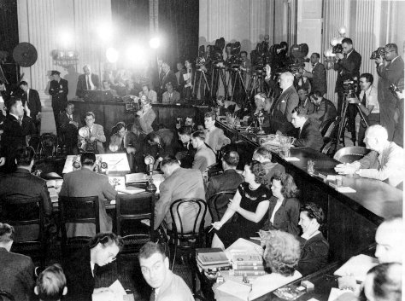
House Committee on Un-American Activities
Originally founded in 1934 to investigate Nazis in the United States

Slide 4
The Fair Labor Standards Act, 1938
Established the 44 hour week, and overtime after 44 hours (went to 40 hours a few years later)
Established the minimum wage
Banned child labor for companies that engaged in interstate commerce
Agricultural workers exempt from its hours provisions

Slide 5
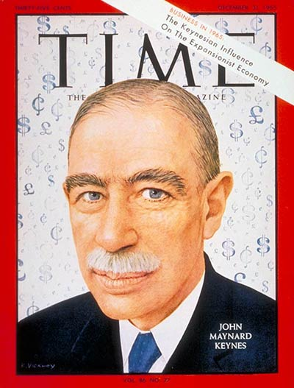
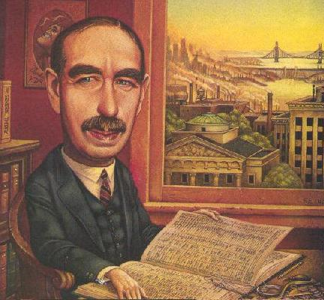
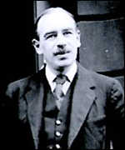

Slide 6
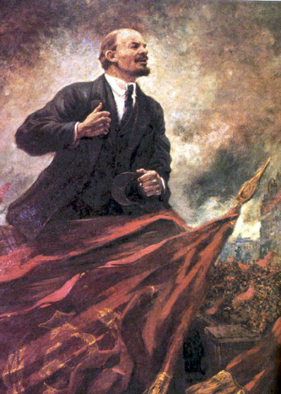
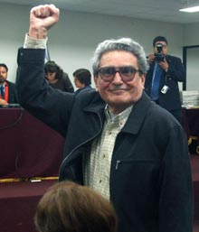
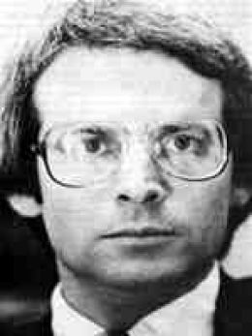
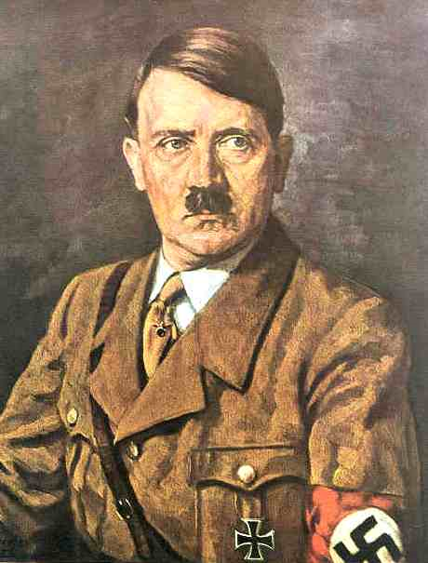
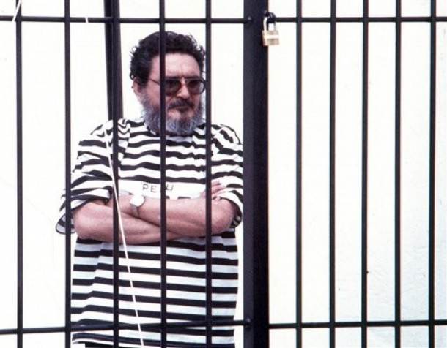
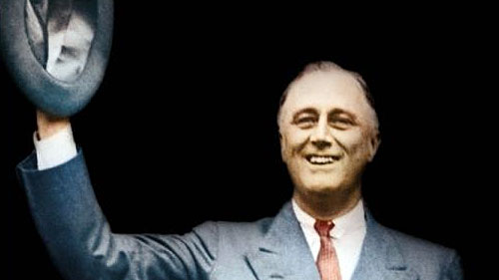
FDR prevented “a naked confrontation between orthodoxy and revolution. The priceless value of that achievement . . . Must be reckoned with in any final accounting of the New Deal.”

Slide 7
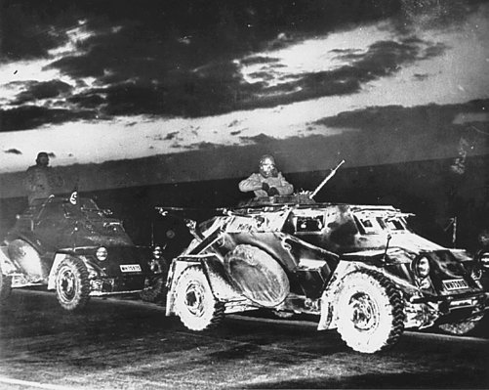
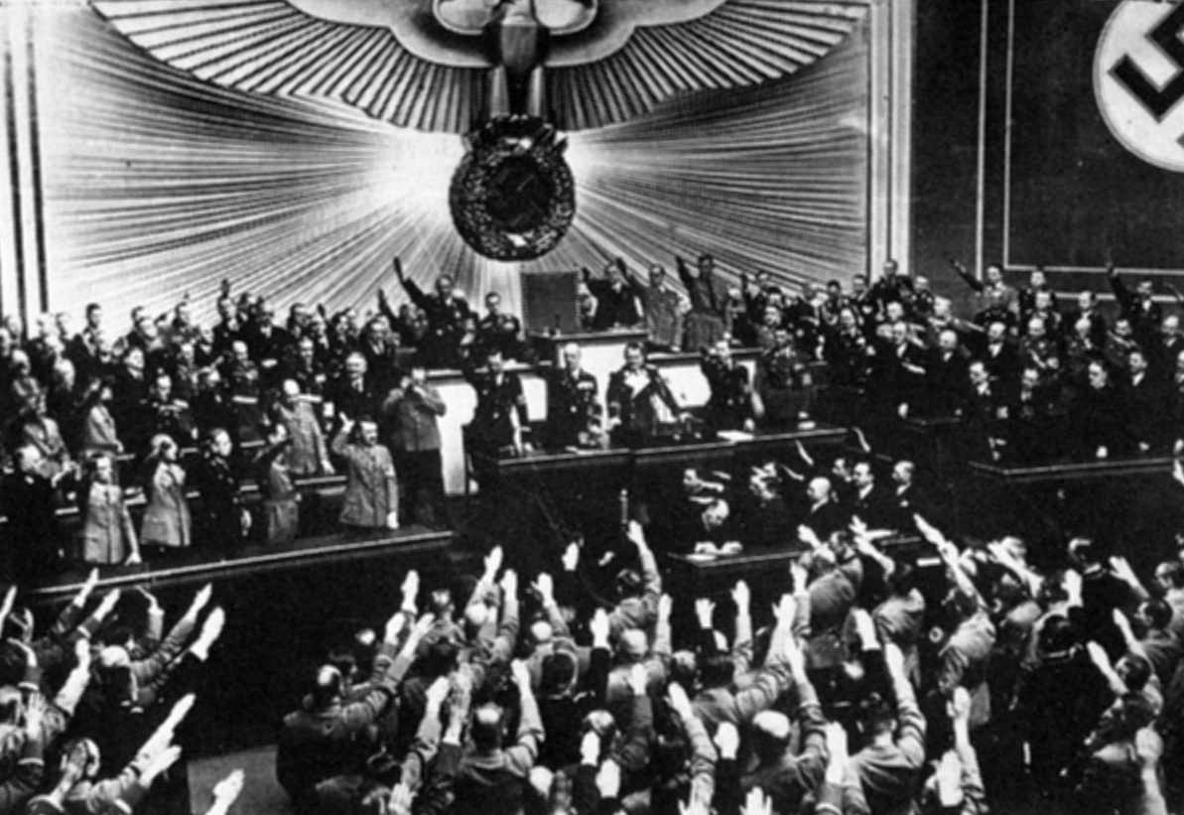
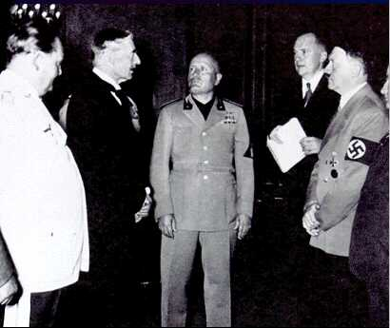
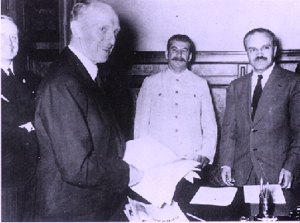
Hitler’s road to empire, 1936-1939

Slide 8
The roots of appeasement
Disillusionment with World War I; a huge pacifist movement
Guilty feelings about the treaty of Versailles
Hitler was a good liar
Fear of communism
Anti-communism

Slide 9
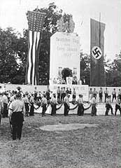
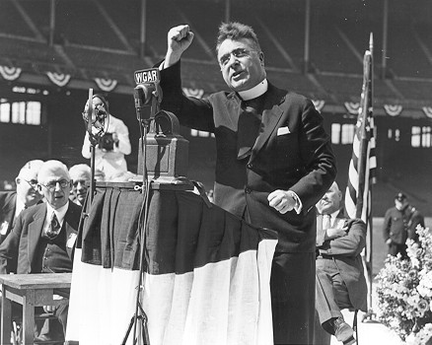
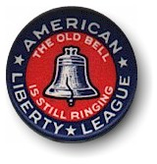
Camp Siegfried
Father Charles Coughlin

Slide 10
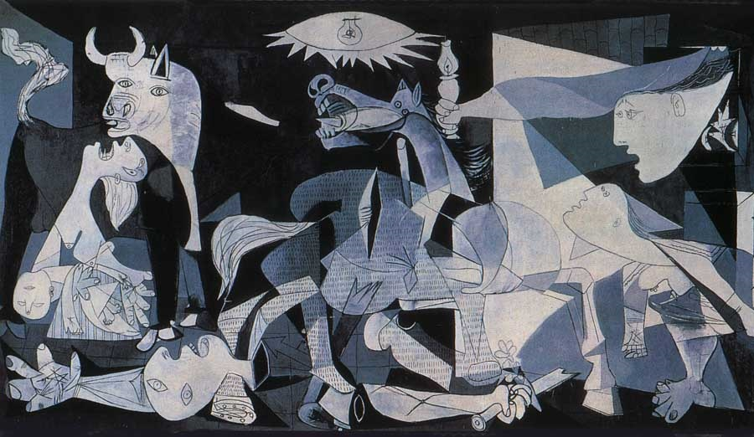
The Neutrality Acts, 1935-1937
Prohibited U.S. ships from transporting war materials to belligerents
Prohibited loans to belligerents
Forbade U.S. citizens from traveling on belligerent ships
Declared the U.S. neutral on the question of the Spanish Civil War

Slide 11
Guernica, 1937, Pablo Picasso

Slide 12
Refugee conference in Evian, France

Slide 13
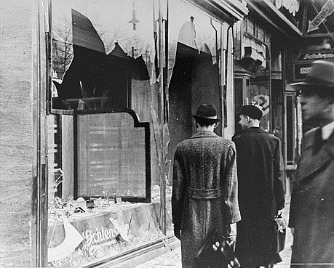
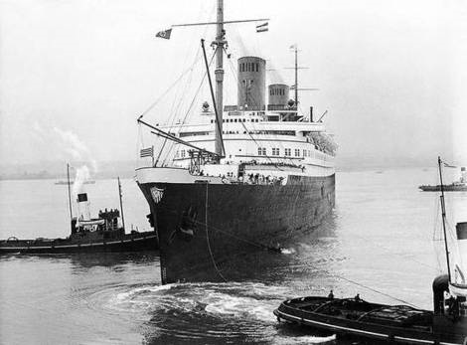
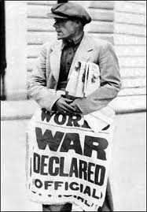
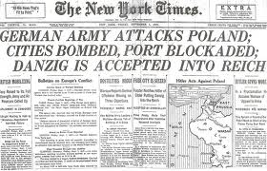

Slide 14
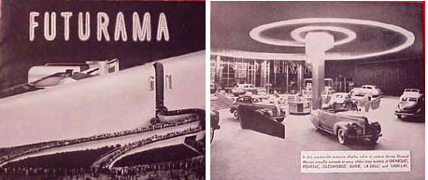

Slide 15
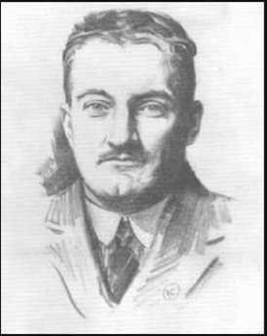
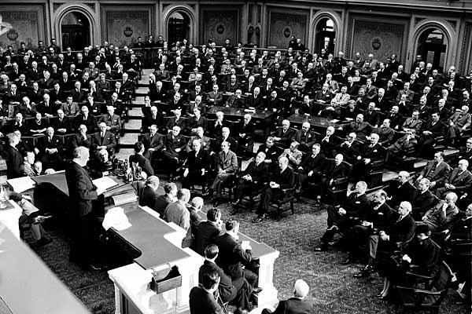
Opponents of the draft (Burke-Wadsworth Bill), 1940
Liberals who regretted their support of the First World War
Pacifist college students
The Communist Party, still defending the Soviet pact with Hitler
Union leaders
Conservative/isolationist newspapers and organizations
FDR before joint session of Congress, June 14, 1940

Slide 16
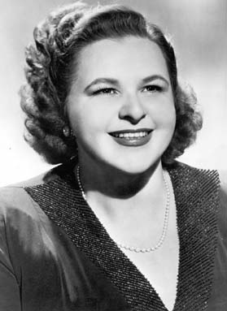
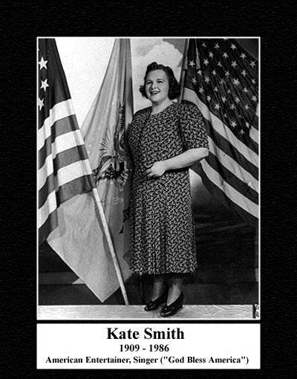
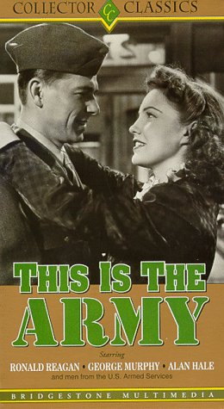

Slide 17
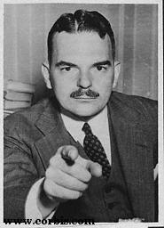
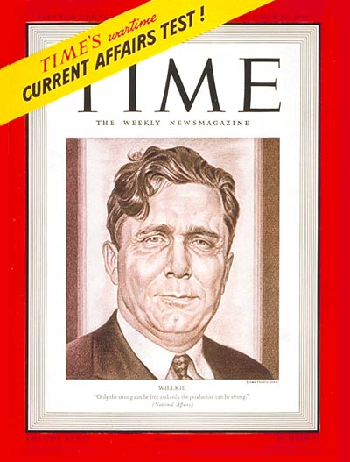
Tom Dewey

Slide 19
God damned Republicans
Scum of the Earth.
We will meet them, and beat them
In a fight with the right on our side.
Out of Wall Street, came a Wilkie.
He’s a silky SOB.
God damned Republicans.
That’s G . . . O . . . P.
God damned Republicans.
That’s G . . . O . . . P.

Slide 20
Wendell Wilkie challenges FDR in 1940
Objects thrown at Wilkie during 1940 campaign (as recorded by The New York Times)
a heavy wooden office chair aimed from a high window
a large garbage can, similarly propelled
a big-city telephone directory
several hallway light bulbs
many rocks, eggs and boxes of produce
and a five pound steel wastebasket thrown in Detroit by a government secretary
Wilkie lost: 55 to 45 percent of the vote
Closest race since 1916

Slide 21
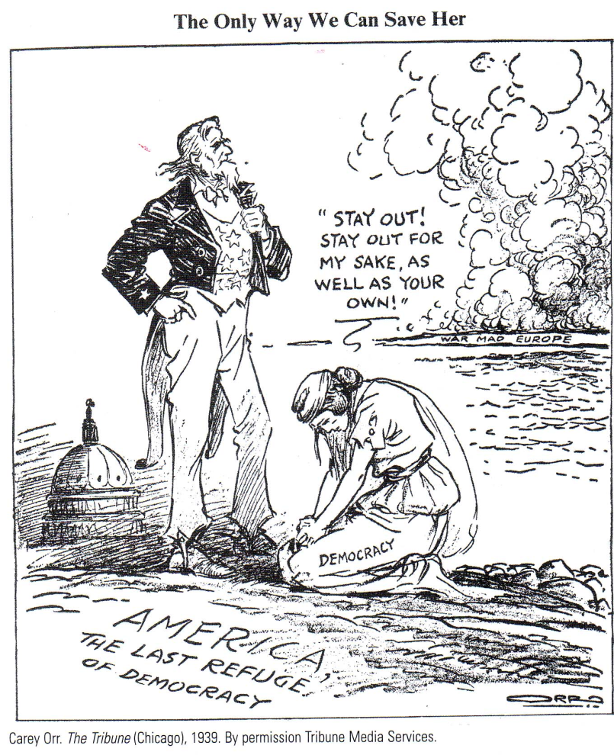
The isolationists
Klansmen
Prohibitionists
Nativists
Pacifists
Communists
Libertarians

Slide 22
The interventionists (Committee to Defend America)
Hitler more dangerous than the Kaiser
Fears of Europe unified under one power (Germany)
Saw isolationists as socially backward

Slide 23
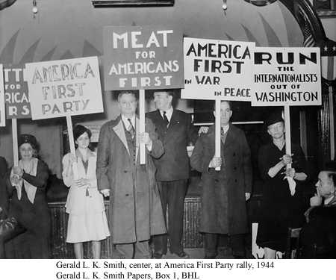
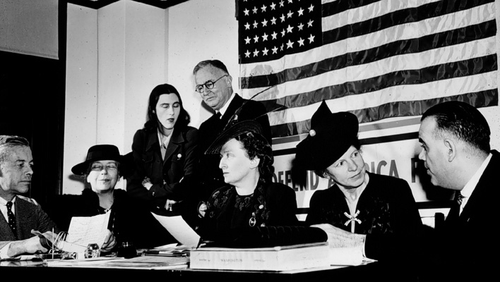
The America First Committee

Slide 24
Dr. Seuss goes after America First

Slide 25
Three options for running the war
Liberals: adopt the British state run economy (like World War One)
Military: let the military run everything
Business community: let the business community run everything and dismantle the New Deal

Slide 26
Revenue Act of 1940
Authorized expansion of national debt to pay for defense program
Income tax exemptions cut by 25 percent
A huge multimillion dollar defense bond authorized

Slide 27
Lend Lease, HR 1776, March 1941
President authorized to direct “defense articles” to any purpose
(a) The term "defense article" means - (1) Any weapon, munition. aircraft, vessel, or boat; (2) Any machinery, facility, tool, material, or supply necessary for the manufacture, production, processing, repair, servicing, or operation of any article described in this subsection; (3) Any component material or part of or equipment for any article described in this subsection; (4) Any agricultural, industrial or other commodity or article for defense.

Slide 28
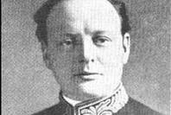
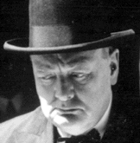
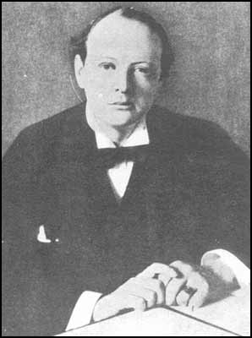
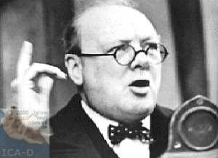
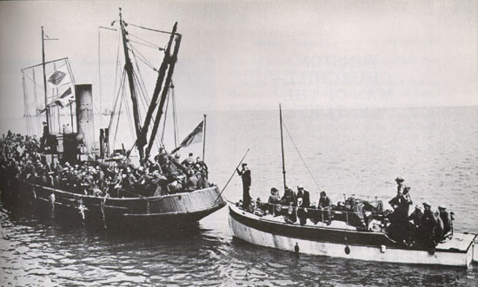
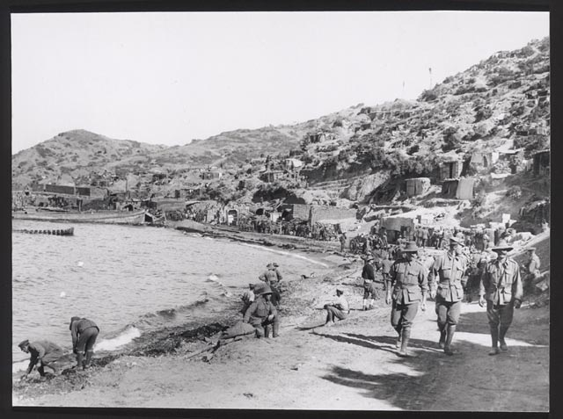

Slide 29
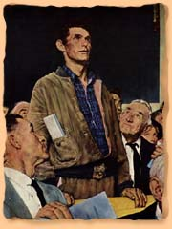
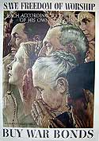
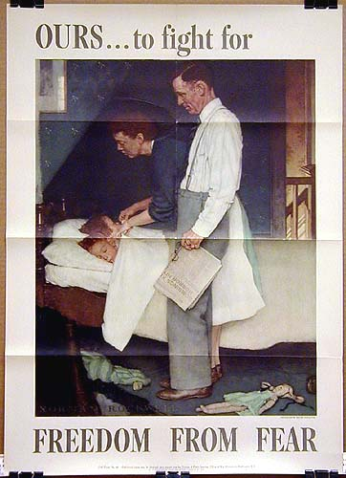
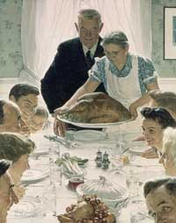
FDR’s Four Freedoms via Norman Rockwell

Slide 30
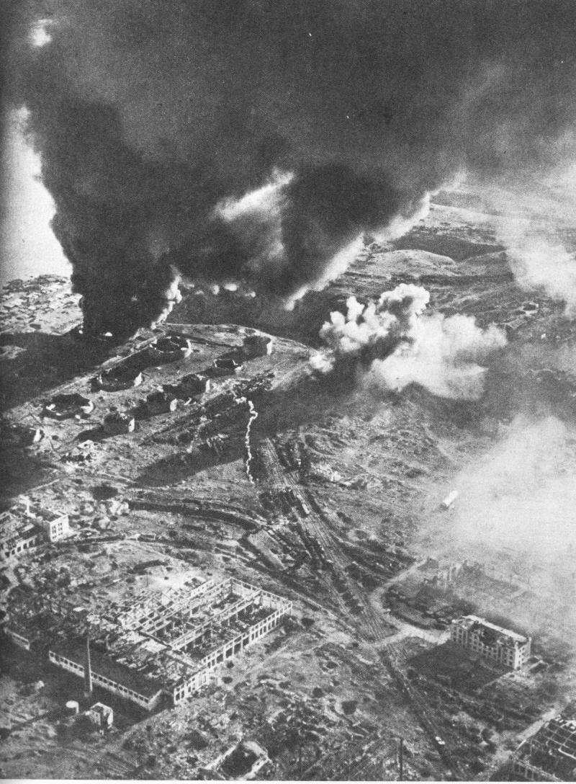
June 22, 1941: Hitler attacks the Soviet Union

Slide 31
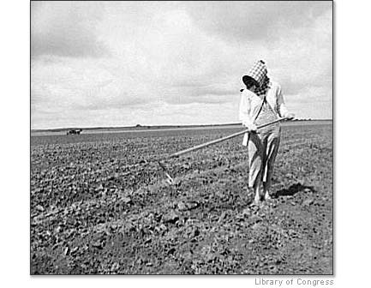
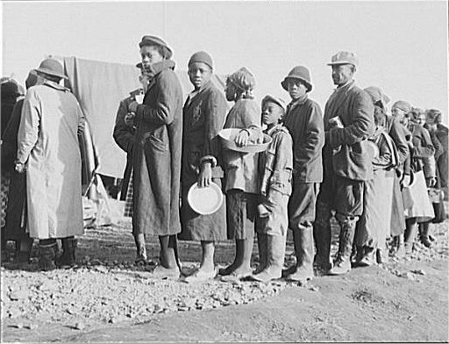

Slide 32
The Smith Act (1940)
"Whoever knowingly or willfully advocates, abets, advises, or teaches the duty, necessity, desirability, or propriety of overthrowing or destroying the government of the United States . . .
. . . shall be fined under this title or imprisoned not more than twenty years, or both . . . ”

Slide 33
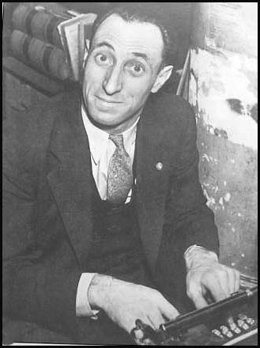
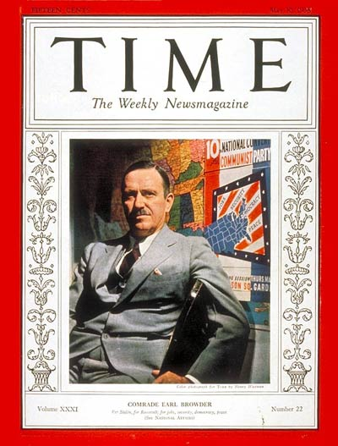
Harry Bridges

Slide 35
Executive Order 8802 (June 25, 1941)
Prohibited discrimination in defense jobs
Established Fair Employment Practices Commission
A. Phillip Randolph

Slide 36
Lindbergh warns the Jews (November 1941)
“Their greatest danger lies in their large ownership and influence in our motions pictures, our press, our radio, and our government.”

Slide 38
Japan, 1868-1941
1868: Meiji restoration
1895 through 1905: victories over China and Russia
1931: Conquest of Manchuria
1941: attack on Pearl Harbor

Slide 39
Tojo
Koyoye

Slide 40
Troubling questions about World War II
How could the U.S., a white supremacist society, claim to be fighting a war against Hitler’s racism?
How could the U.S. claim to be fighting against totalitarianism when allied with the Soviet Union?

Slide 41
First Filipino Infantry Regiment

Slide 42
Col. Young-Oak Kim (center top), prominent officer in the 100th Battalion 442nd Regimental Combat Team, both, made up predominantly of Japanese American soldiers, some of whose families were interned during World War II

Slide 44
The Atlantic Charter Conference

Slide 45
The Chinese Exclusion Act repealed in 1943

Slide 47
Executive Order 9066 February 19, 1942
“I hereby authorize and direct the Secretary of War, and the Military Commanders whom he may from time to time designate, whenever he or any designated Commander deem such action necessary or desirable to prescribe military areas in such places and of such extent as he or the appropriate Military Commander may determine, from which any or all persons may be excluded, and with respect to which, the right of any person to enter, remain in, or leave shall be subject to whatever restriction the Secretary of War or the appropriate Military Commander may impose in his discretion. The Secretary of War is hereby authorized to provide for residents of any such area who are excluded therefrom. such transportation, food, shelter, and other accommodations as may be necessary, in the judgment of the Secretary of War or the said Military Commander and until other arrangements are made, to accomplish the purpose of this order.”
Franklin Roosevelt, February 19, 1942

Slide 48
Japanese-American camps, 1942-1946

Slide 49
Two questions for interned Nisei men
27. Are you willing to serve in the armed forces of the United States, or combat duty?
28. Will you swear unqualified allegiance to the United States of America and faithfully defend the United States from any or all attacks by foreign or domestic forces, and foreswear any form of allegiance or obedience to the Japanese empire?

Slide 50
Korumatsu vs. the United States, 1944
Supreme Court: “He was excluded because we are at war with the Japanese Empire, because the properly constituted military authorities fear an invasion of our West Coast . . . “

Slide 52
The volunteer war economy

Slide 54
Casablanca (1942)
Peter Lorre; Sidney Greenstreet; Ingrid Bergman; Claude Rains; Humphrey Bogart; Paul Henreid

Slide 57
World War II saw the armed forces take the first small steps towards integration of the services; top right: a soldier from the 761st Tank Battalion.

Slide 59
The managed volunteer war economy
Rationing of gas, meat, butter, coffee, tires, and other key commodities
1942: “General Max” capped prices as of March 1942
Wage increases capped at rise of cost of living, about 15 percent
Revenue Act of 1942 lowered personal exemption to $624 a year in income, added millions of Americans to the tax system

Slide 61
The GI Bill, 1944-1955
4,300,000 home loans to veterans (worth 33 billion dollars)
8 million veterans went back to school with a GI bill scholarship
14.5 billion dollars in federal money going to the nation’s schools and colleges
50 billion in direct or indirect subsidies to the American people
1/3 of the population received some sort of benefit from the GI Bill
Dr. Hector Garcia of the American GI Forum

